Slide 1
Orthopaedic Surgery

Slide 2
Bone and muscle physiology

Slide 3
Bone
Functions
Responds to stresses encountered and changes architecture accordingly (Wolf’s law)
Source of calcium and phosphate
Structural framework for muscles
Haematopoesis (blood cell production)
Protects organs
Hormones acting on bone
Vitamin D – increases calcium and phosphate absorption in intestines and stimulates osteoclasts (bone breakdown)
PTH – produced in response to low calcium to activate osteoclasts
See hyperparathyroidism
Calcitonin – produced in C cells in thyroid to stop bone reabsorption and increase calcium excretion
T4 – catabolic
Growth hormone
Glucocorticoids - high levels cause increased bone reabsorption, resulting in osteoporosis
Nutrition and bone health
Calories
Calcium
Vitamin D
Other (phosphate, fluoride, magnesium, vitamin C)
Aging and bone structure
Remodelling (bone formation and breakdown) occurs throughout life
>40 years → slow loss of bone and thinning of trabeculae (causing osteoporosis)

Slide 4
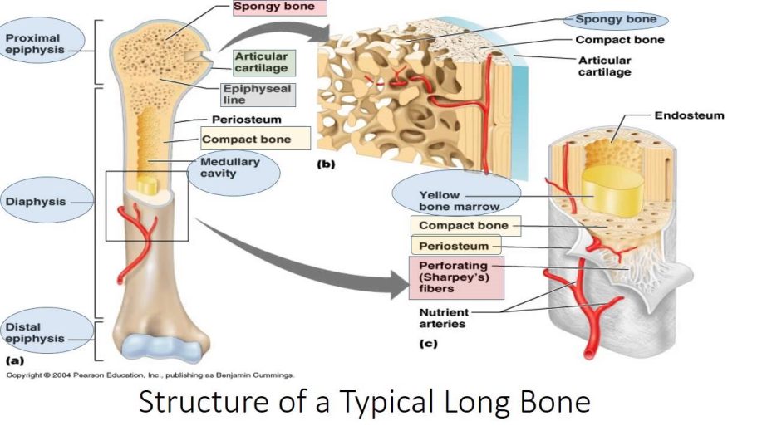
Structure of Bone
Structure - https://www.google.co.uk/url?sa=t&rct=j&q=&esrc=s&source=video&cd=8&cad=rja&uact=8&ved=0ahUKEwik0azT5_zYAhURh6YKHR5AACsQtwIIUDAH&url=https%3A%2F%2Fwww.youtube.com%2Fwatch%3Fv%3De4eCfIAjZOs&usg=AOvVaw3QI08PJ11zsop8-3AHkSx7
Organic matrix – bone proteins and bone forming cells
Bone proteins = type 1 collagen
Bone forming cells
Osteoblasts - lay down collagen in random weave or layered (lamellar) pattern
Osteocytes – maintain bone; communicate via canaliculi
Osteoclasts – resorb bone by releasing enzymes
Inorganic matrix – calcium hydroxyapatite
Types of bone
Woven bone
Immature – fetal skeleton
Rapid bone formation
Irregular collagen
Mechanically weak
Lamellar bone
Orderly arrangement of collagen
Mechanically strong
Replaces woven bone but takes time
Can be cortical (rigid)/cancellous (contains marrow)
Periosteum
Cover bones
Has two layers (cambrial and fibrous)
Functions: anchor for tendons, source of osteoprogenitor cells that produce osteoblasts, nutrition

Slide 5
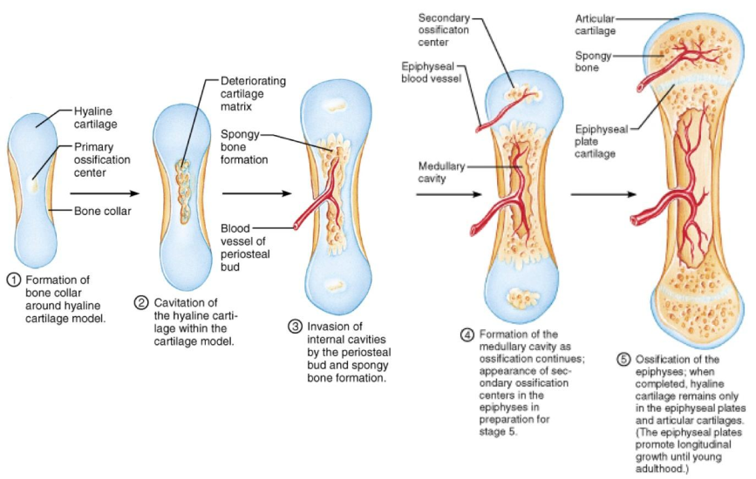
Bone Development
Structure
Diaphysis – tube of cortical bone; primary ossification centre
Metaphysis – conical area of cancellous bone facilitating load transfer from articular surface to diaphysis
Physis – growth plate; site of longitudinal growth
Four zones: resting zone, proliferative zone, hypertrophic zone, zone of provisional calcification
Epiphysis – secondary ossification
Blood supply (in general)
Nutrient artery – supples bone marrow and trabecular bone
Vessels with tendons and ligaments – supplies periosteum
Circulus vasculosis – arterial plexus that surrounds and supplies epiphysis
Blood supply (to long bone)
Nutrient artery – supples diaphysis
Metaphyseal vessels – supplies metaphyseal region
Epiphyseal vessels
Periosteal vessels

Slide 6
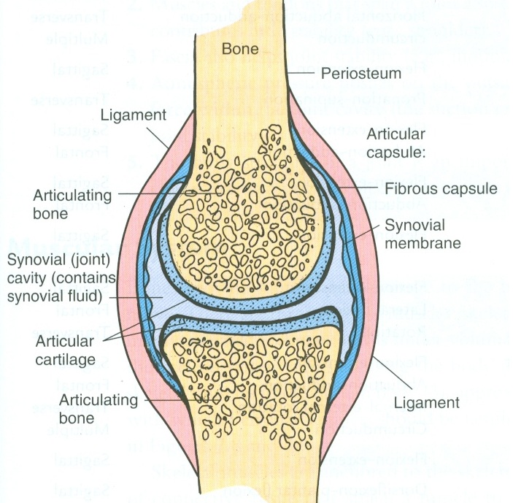
Joint Structure
Where two bones come together
Classification:
Immovable joints (synarthroses) - skull
Slightly moveable joints (amphiarthroses) – manubriosternal joint
Freely moveable joints (diarthroses) – has synovial joint
Ball and socket - shoulder
Condyloid – MCP joints
Saddle - thumb
Pivot – atlantoaxial joint
Hinge - elbow
Gliding - vertebral column facet joints
Structure
Fibrous – lacks joint cavity
Sutures
Syndesmosis
Gomphosis
Cartilaginous
Synchondrosis – bone and hyaline cartilage meet
Symphysis – two bones unite by fibrocartilage
Synovial – have joint cavity and bones covered in hyaline cartilage, has synovial membrane which produces synovial fluid
Diseases of the bone that affect growth/structure
Osteogenesis imperfecta – disorder of type 1 collagen
Achondroplasia – swarfism

Slide 7
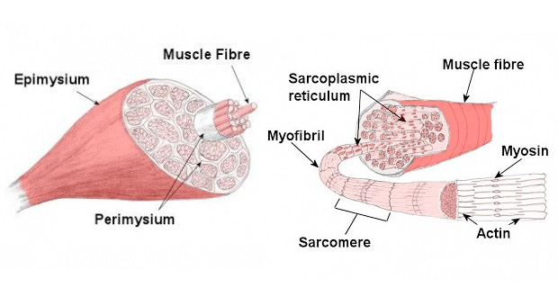
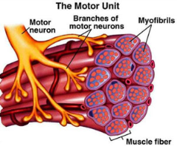
Muscle Structure
Features:
Contractility – shortens in response to stimuli
Excitability – ability to react to stimulus
Extensibility – ability to undergo stretch
Elasticity – ability to return to original size/shape
Types
Skeletal (striated)
Contraction causes skeletal movements
Twitch/isotonic contraction/isometric contraction/treppe/tetanus
Fibres
Type 1 – rich in myoglobin, slow twitch, lots of mitochondria
Type 2 – fatigue easily, fast twitch, rapid movement
Voluntary control
Innervation – motor neurones with branching axons that terminate in neuromuscular junction (makes up motor unit)
Impulses transferred to muscle via acetylcholine realse in synapse → activation of muscle → release of calcium → myosin binds to actin → bonds break (using ATP) → filaments pulled along each other https://www.google.co.uk/url?sa=t&rct=j&q=&esrc=s&source=video&cd=2&cad=rja&uact=8&ved=0ahUKEwiT4-_T4PzYAhUJ3SwKHQuWAkoQtwIILzAB&url=https%3A%2F%2Fwww.youtube.com%2Fwatch%3Fv%3DcnAbzz3N0ak&usg=AOvVaw2dVp19Xi_ZCQZ-1RdzVN91
Smooth
Found in walls of arteries and veins
Single spindle shaped cells
Doesn’t require motor neurones, is stimulated by autonomic nervous system and hormones
Involuntary
Cardiac
Striated
Action potential generated in heart

Slide 8
Joint pathology

Slide 9
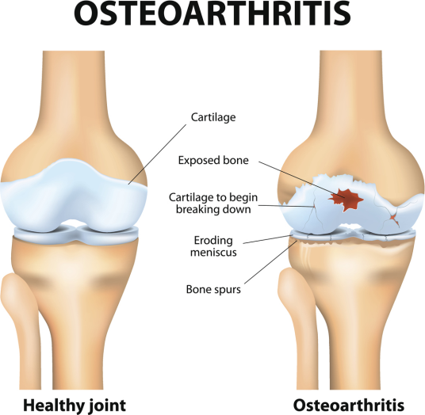
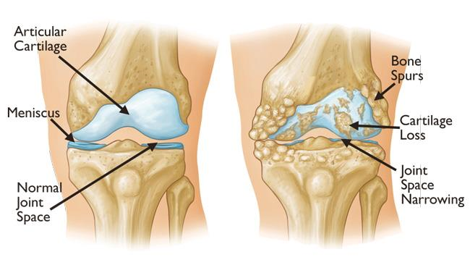
Osteoarthritis
Affect synovial joints – damage to hyaline cartilage
Age causes thinner cartilage which is more vulnerable to injury
Grading of degeneration
Grade 1 – softening of articular cartilage
Grade 2 – fibrillation and fissuring
Grade 3 – partial thickness loss
Grade 4 – full thickness loss
Classification:
Primary – no underlying cause
Secondary – trauma, RA, developmental, diabetes, paget’s
S: pain (due to thickened synovium, muscle spasm and exposed joint surfaces), stiffness
Features:
Radiological: loss of joint space, osteophyte formation, articular sclerosis, subarticular cysts
Tx:
conservative (pain relief, physio)
surgical – realign/excise/fuse/replace

Slide 10
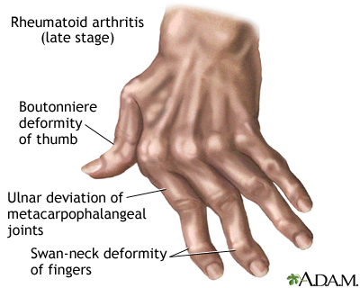
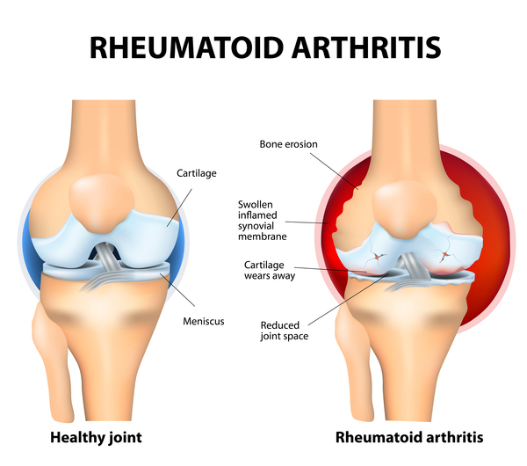
Rheumatoid Arthritis
Symmetrical polyarthropathy with systemic manifestations, affecting synovial membrane
Inflammtory synovitis → CD4 T cells activated → autoantibodies produced (rheumatoid factor)
Causes: EBV, genetic (HLA-DR4)
S: raised ESR/CRP, early morning stiffness lasting 1 hour, rheumatoid nodules, deformities (boutonniere, swan neck, Z thumb)
Radiological features
Loss of joint space
Periarticular erosions
Joint line thickening
No osteophytes
Articular osteoporosis
Management
Stop synovitis/prevent deformity/reconstruct diseased joints/rehab
Conservative (NSAIDs, DMARDs, steroids)
Surgical (synovectomy, arthrodesis, replacement, excision athroplasty, tendon reconstruction)

Slide 11
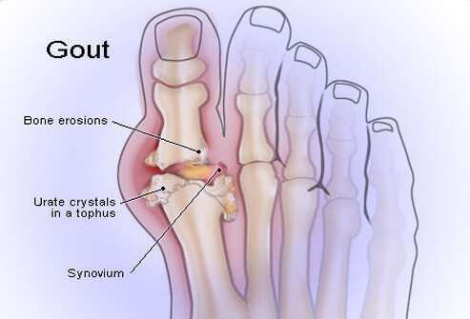
Gout
Commonly affects MTP joint in great toe
S: recurrent attacks of acute arthritis triggered by crystallisation of monosodium urate
Causes: primary (idiopathic increased uric acid production), secondary (diuretics, chronic renal failure)
Pathological features
Acute arthritis – acute synovitis stimulated by monosodium urate (negative birefringent on microscopy)
Chronic arthritis – urate stimulates pannus (inflammatory overgrowth)
Tophi – urate deposition in tissue
Kidney disease – uric acid nephropathy
Tx: exclude infection, NSAIDs (colchicine), prophylaxis with allopurinol (decreases uric acid production)
Only start allopurinol after acute attack

Slide 12
Pseudogout
Similar to gout
Affects knee
Crystals of calcium pyrophosphate
Positively birefringent under polarised light microscopy
Tx: rest, aspiration, steroid injections

Slide 14
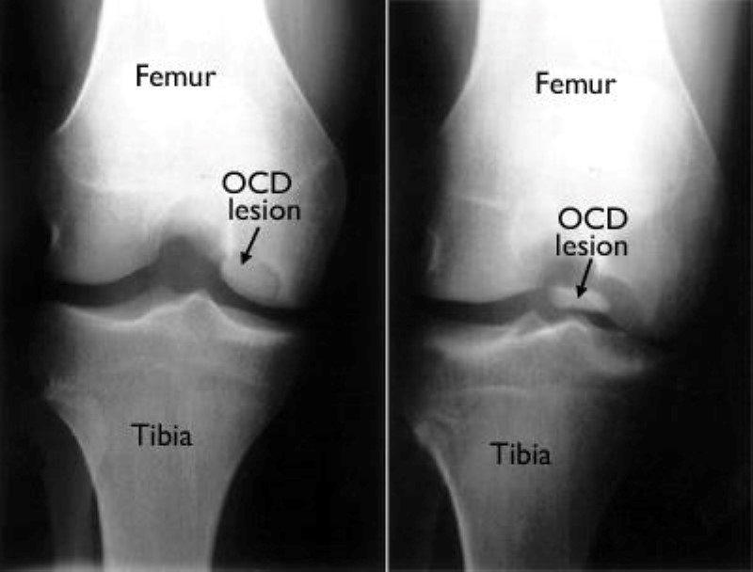
Osteochondritis Dissecans
Detachment of fragment of articular cartilage/bone
Avascular areas of subchondral bone more susceptible
Commonly affects convex joint surfaces
Causes: idiopathic, repetitive truama, genetic, post-steroid
S: pain worse on activity, joint effusions, locking, giving way of joint
Ix: MRI
Tx: rest, immobilisation, surgical (pinning of loose fragment)

Slide 15
Bone pathology

Slide 16
Osteoporosis
Increased porosity of bone leading to decreased bone density and increased risk of fractures
BD 2.5 standard deviations below the normal range
Pathogenesis
Amount of bone resorbed exceeds the amount made
Causes
Primary – postmenopausal, age-related
Secondary – neoplasia (multiple myeloma), drugs (steroids, chemo, alcohol), endocrine (thyroid problems), GI (malnutrition), disease (RA, TB), mechanical (immbolisation)
RF: smoking, reduced physical activity, nutritional state, early menopause
S: low trauma fractures, vertebral fracture in thoracic/lumbar spine, #NOF
Ix: DXA scan
Tx: prevention (calcium supplements), exclude secondary cause, assess bone density (FRAX score), meds (bisphosphonates)

Slide 17
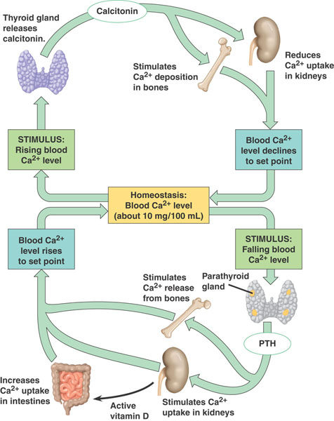
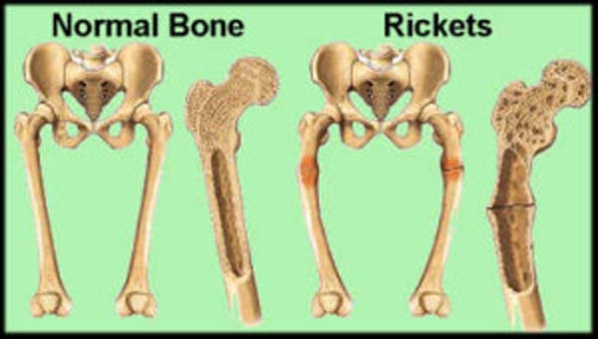
Rickets/Osteomalacia
Rickets in children, osteomalacia in adults
Caused by deranged vitamin D absorption/metabolism which causes impaired mineralisation of bone
Vitamin D maintains normal calcium and phosphate levels
Produced in skin and converted to active form in kidneys/from diet
Causes of deranged vitamin D
Inadequate synthesis – poor UV exposure
Decreased absorption – cholestatic liver disease, biliary tract obstruction
Poor production – renal osteodystrophy
Phosphate depletion – poor absorption due to antacid use
Overall management: prevent by correcting deficiencies, treat complications (SUFE, fractures)
Rickets
S: bone pain and tenderness, delayed walking, deformed skeleton (flat occiput, frontal bossing, pigeon chest)
Radiological features: loosers lines, osteopenia
Ix: low calcium, low phosphate, high ALP
Osteomalacia
S: fatigue, bone pain, pathological fractures
Ix: to diagnose, trial Vit D replacement, ALP/PTH high

Slide 18
Paget’s Disease of Bone
Excessive disorganised bone turnover
Three phases
Osteolytic – mediated by osteoclasts → bone resorption causes osteolytic lesions
Reparative –mediated by predominance of osteoblasts → rapid bone formation
Inactive – osteosclerotic stage → little cellular activity
Aetiology – unclear, ?genetic (HLA)
S: asymptomatic; affects pelvis, lumbar/thoracic spine, femur, skull (can compress CN roots and cause headache/neurology), sacrum, tibia, humerus; bone pain; femur bowing; chalk stick fractures
Ix: HIGH ALP, XR
Tx: bisphosphonates, calcitonin, surgery if neurological compression
Linked to tumours (benign or malignant (sarcoma, osteosarcoma))

Slide 19
Hip and thigh
https://www.youtube.com/watch?v=RHJwCzzWqhE&list=PLF951931B19317229 – ANATOMY OF LOWER LEG

Slide 20
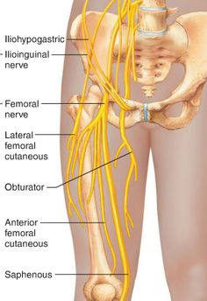
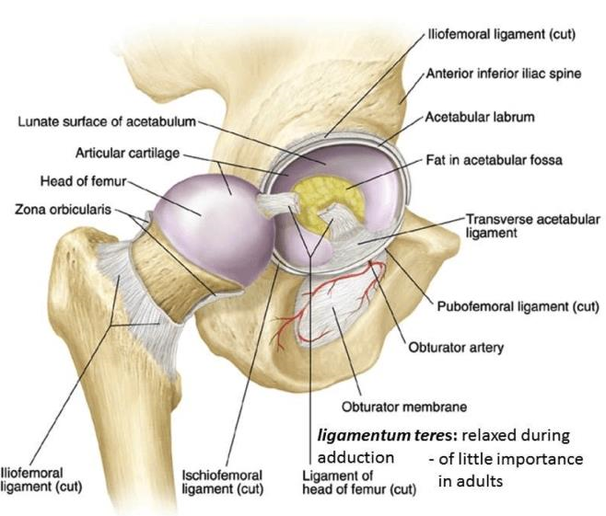
Anatomy of Hip
Ball in socket (femur and acetabulum)
Trochanters = insertion points for muscles
Greater = piriformis, obturator externus, obturator internus,
gluteus medius, gluteus minimus, gemelli
Lesser = psoas, iliacus
Ligaments of Hip
Acetabular labrum (ring of fibrocartilage round acetabulum)
Iliofemoral ligament
Pubofemoral
Ischiofemoral
Blood supply of hip
Medial circumflex femoral
Lateral circumflex
Ligamentum teres
Nerve supply
Femoral, obturator and sciatic nerves
Hiltons law = nerve trunk supplying a
joint also supplies the overlying skin
and muscles that move the joint
https://www.google.co.uk/url?sa=t&rct=j&q=&esrc=s&source=video&cd=5&cad=rja&uact=8&ved=0ahUKEwjEzaD_mP_YAhUIWSwKHc16CtcQtwIIPjAE&url=https%3A%2F%2Fwww.youtube.com%2Fwatch%3Fv%3DZWcdMj8wRos&usg=AOvVaw0dZgJKz-SCOVl2Q1FW5nv5

Slide 22
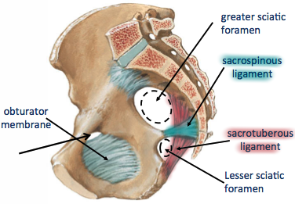
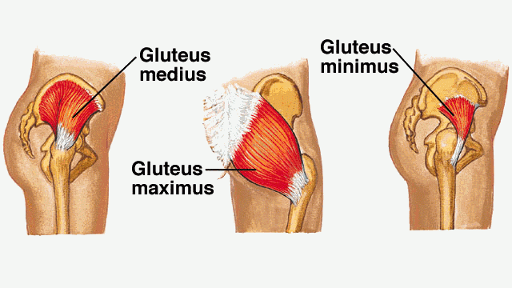
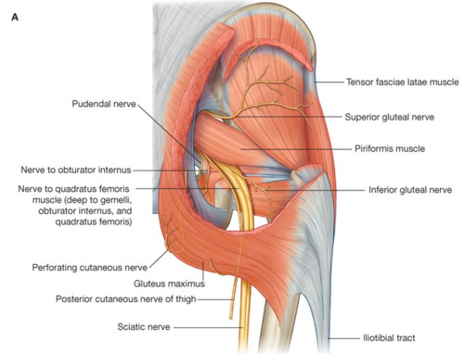
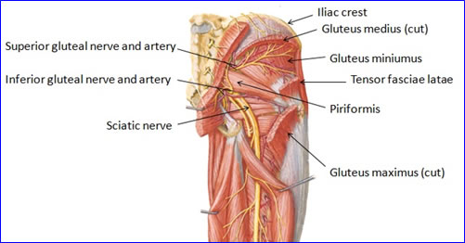
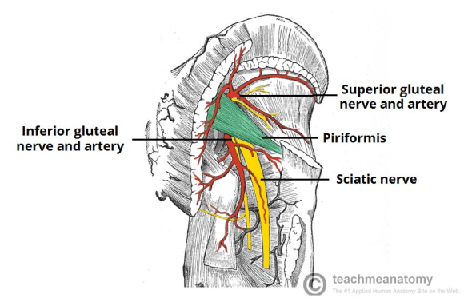
Anatomy of Gluteal Region
https://www.google.co.uk/url?sa=t&rct=j&q=&esrc=s&source=video&cd=6&cad=rja&uact=8&ved=0ahUKEwiokYHHm__YAhULliwKHTwcBiYQtwIIRzAF&url=https%3A%2F%2Fwww.youtube.com%2Fwatch%3Fv%3DkXg3akhbrrg&usg=AOvVaw0B62oASlfAx8gI5QBSLLYn PART ONE
https://www.google.co.uk/url?sa=t&rct=j&q=&esrc=s&source=video&cd=7&cad=rja&uact=8&ved=0ahUKEwiokYHHm__YAhULliwKHTwcBiYQtwIITTAG&url=https%3A%2F%2Fwww.youtube.com%2Fwatch%3Fv%3DcF0zy4ub1V4&usg=AOvVaw2p8lQUrRvRnNDAov90okpJ PART TWO
Contains:
Gluteus muscles
Maximus is largest muscle in body and is supplied by inferior gluteal nerve
Tensor fasciae latae, piriformis, gemelli muscles, obturator internus, quadratus femoris
Extends from iliac crest to gluteal buttock crease
Sciatic foramina – allow passage of vessels and nerves to lower limb
Greater
Superior gluteal nerves, arteries and veins; piriformis; inferior gluteal nerves, arteries and veins; internal pudendal artery and vein; posterior cutaneous nerve of thigh; scaitic nerve; pudendal nerve
Lesser
Pudendal nerve; internal pudendal artery and vein; nerve to obturator and internus
Blood supply
Branches of internal iliac artery (superior and inferior gluteal arteries)
Superior lies above piriformis and inferior lies below
Trochanteric anastomoses supplies head of femur (superior and inferior gluteal arteries + medial and lateral circumflex)

Slide 23
Surgical Approaches to Hip
Anterior approach (Smith – Petersen)
Between sartorius and tensor fascia latae
Risk of damaging: lateral femoral cutaneous nerve, femoral nerve
Anterolateral approach (Watson – Jones)
Between tensor fascia latae and gluteus medius
Risk of damaging: femoral nerve
Direct lateral approach (modified Hardinge)
https://www.google.co.uk/url?sa=t&rct=j&q=&esrc=s&source=video&cd=2&cad=rja&uact=8&ved=0ahUKEwiF-6yCnf_YAhXKliwKHSYjB5IQtwIILzAB&url=https%3A%2F%2Fwww.youtube.com%2Fwatch%3Fv%3DTUb_krVSRro&usg=AOvVaw1A82QaE2Cy0Vrnjgzid-G_
Lateral incision over greater trochanter in line of femur
Posterior approach (Moore)
https://www.google.co.uk/url?sa=t&rct=j&q=&esrc=s&source=video&cd=4&cad=rja&uact=8&ved=0ahUKEwi9vMyQnf_YAhVKFywKHerYAhgQtwIIODAD&url=https%3A%2F%2Fwww.youtube.com%2Fwatch%3Fv%3D0KDX0U1rA9g&usg=AOvVaw0x_znHkWrxBmi2PELVQeDW
Lateral incision over greater trochanter in line of femur
Risk of damaging: sciatic nerve

Slide 24
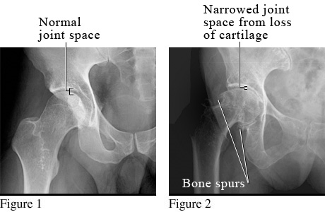
Osteoarthritis of Hip
Causes:
Developmental dysplasia, Perthes’ disease, RA, avascular necrosis, Paget’s
Primary (no cause) or secondary
S: pain and restricted movement
Antalgic gait, muscle wasting, restrictions of movement, shortening of leg
Ix: XR (AP hip)
Loss of joint space, osteophytes, sclerosis and erosion to head of femur
Tx: conservative (strengthen muscles, weight loss, analgesia, physio)
Surgery when conservative measures fail
Arthrodesis (fusion of hip joint)
Osteotomy realignment
Hip replacement – give prophylactic abx

Slide 25
Other Hip Problems
Rheumatoid arthritis
Affects hip in later stages of disease
Requires total hip arthroplasty
Avascular necrosis
Tx: surgical revascularisation or arthroplasty
Clicking hips
Tx: stretch offending structure
Femoral acetabular impingement
Labral tears/loose bodies – painful clunk in hip
Tx: hip arthroscopy
Trochanteric bursitis
Painful inflammation of bursa over greater trochanter, worse lying on side
Ix: MRI
Tx: physio, strecthing, steriod injections
Metabolic bone disorders
Osteomalacia
Osteoporosis
Pagets disease

Slide 26
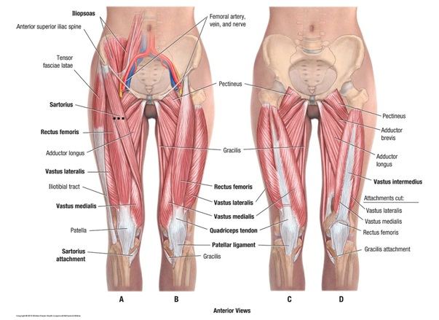
Anatomy of the Thigh
https://www.youtube.com/watch?v=8trLEtQYDGw – PART ONE
https://www.youtube.com/watch?v=MjPAPTJdxa8 – PART TWO
https://www.youtube.com/watch?v=PAMWumkerRA – PART THREE

Slide 27
Blood Supply: profunda femoris artery and obturator artery
Blood Supply: femoral artery
Blood Supply: profunda femoris artery

Slide 28
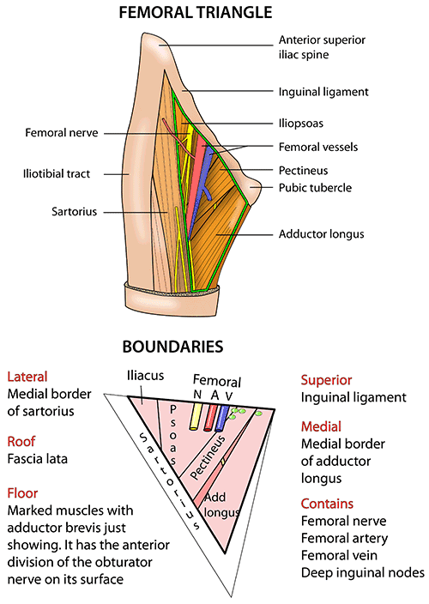
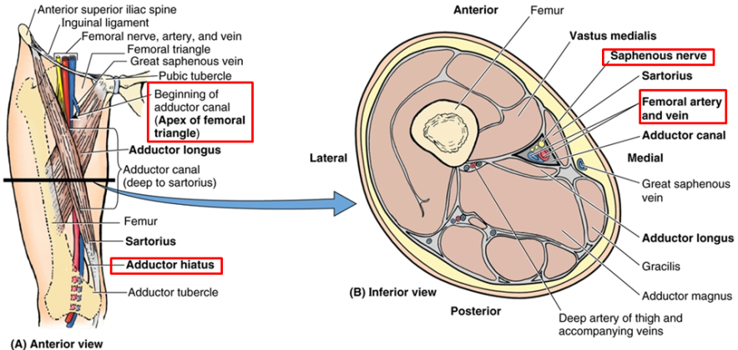
Anatomy of Thigh
Surrounded by fascial sheath attaching to inguinal ligament and bony pelvis
Lateral side forms iliotibial tract
Femoral triangle
Contents
Femoral nerve, artery and vein
Femoral sheath
Deep inguinal nodes
Boundaries
Superior – inguinal ligament
Lateral – Sartorius muscle
Medial – adductor longus muscle
Floor
Iliacus
Psoas tendon
Pectineus
Adductor longus
Vessel enter: nerve → artery → van → canal
Artery, vein and canal are within femoral sheath
Nerve is not!!!
Adductor canal
Contains: femoral artery and vein, saphenous nerve
obturator nerve

Slide 29
knee

Slide 30
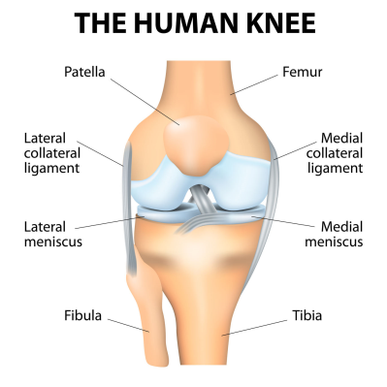
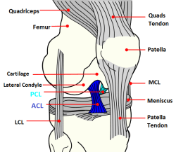
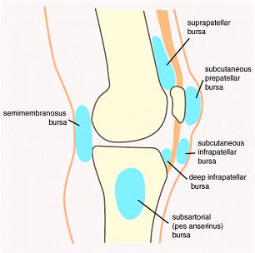
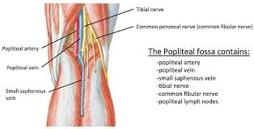
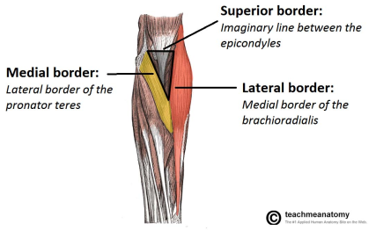
Anatomy of the Knee
https://www.google.co.uk/url?sa=t&rct=j&q=&esrc=s&source=video&cd=4&cad=rja&uact=8&ved=0ahUKEwik3b-Npf_YAhUEDCwKHRuoDT0QtwIIODAD&url=https%3A%2F%2Fwww.youtube.com%2Fwatch%3Fv%3Dt0_U52KWkxY&usg=AOvVaw37faWIyBiHYbqqkTVVSXAu
Modified synovial hinge joint
Allows extension (quadriceps femoris), flexion (hamstring, gastrocnemius, sartorius) and small rotation (popliteus)
Articular surfaces covered with hyaline cartilage
Tibia, femur and patella
Stability of knee from cruciate and collateral ligaments
Menisci increase area of contact across joint
Ligaments
ABUL (anterior goes backwards, upwards and laterally)
Collateral
Menisci
Bursae
Popliteal fossa
Contents:
Popliteal artery and vein
Small saphenous vein
Common peroneal nerve
Tibial nerve
Posterior cutaneous nerve of thigh
Genicular branches of obturator nerve
Lymph nodes

Slide 31
Surgical Approaches to the Knee
Medial parapatellar approach
Longitunidal incision in midline
Medial meniscectomy approach
Incision from medial border of patella
Posterior approach
https://www.google.co.uk/url?sa=t&rct=j&q=&esrc=s&source=video&cd=5&cad=rja&uact=8&ved=0ahUKEwj-3PKfpf_YAhWFCywKHUN3B_UQtwIIRDAE&url=https%3A%2F%2Fwww.youtube.com%2Fwatch%3Fv%3D8uhHUsiN7hY&usg=AOvVaw1kUc310v0CgPmQLkf2MVoe

Slide 32
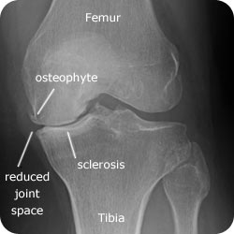
Osteoarthritis of the Knee
Primary/secondary
More common on medial side
S: pain and stiffness that improves on exercise, limp, reduced ROM, swelling, osteophytes
Ix: XR
Loss of joint space, osteophytes, periarticular sclerosis, bone cysts
Tx:
Conservative (analgesia, walking aids, physio, steroid injections)
Surgery
Arthroscopy – if locking/giving way
https://www.google.co.uk/url?sa=t&rct=j&q=&esrc=s&source=video&cd=2&cad=rja&uact=8&ved=0ahUKEwjoh57Cpv_YAhXCCiwKHSuZClEQtwIILTAB&url=https%3A%2F%2Fwww.youtube.com%2Fwatch%3Fv%3DpguNCtOwzEc&usg=AOvVaw2tD5Dq5TB08n477j-x8vui
Chondrocyte transplantation – experimental
Arthrodesis
https://www.google.co.uk/url?sa=t&rct=j&q=&esrc=s&source=video&cd=3&cad=rja&uact=8&ved=0ahUKEwjx7cnLpv_YAhUC3CwKHXlsDawQtwIILzAC&url=https%3A%2F%2Fwww.youtube.com%2Fwatch%3Fv%3DgRIqtfAkeEg&usg=AOvVaw1cTII4wyc_OTpw7xJ9xIUG
Osteotomy
Replacement arthroplasty – replace affect compartment/whole tibiofemoral articulation

Slide 33
Foot and ankle

Slide 34
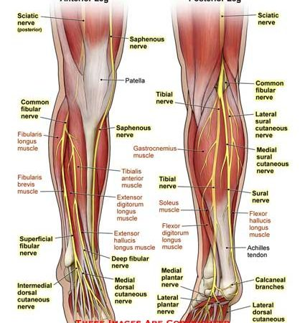
Anatomy of Lower Leg
Peripheral nerves
Common peroneal nerve – supplies EXTENSORS
Branch of sciatic
Motor
Deep branch supplies anterior compartment (tibialis anterior, extensor hallucis longus, extensor digitorum longus, peroneus tertius, extensor digitorum brevis)
Superficial branch supples lateral compartment (peroneus brevis, peroneus longus)
Sensory - first web space, dorsum of foot, anterior lower limb
Injury = loss of anterior/lateral muscles, loss of foot dorsiflexion (foot drop), high stepping gait
Tibial nerve – supplies FLEXORS
Branch of sciatic
Motor
Soleus, tibialis posterior, flexor hallucis longus, flexor digitorium longus, plantaris, popilteus, gastrocnemius, muscles in sole of foot (via plantar nerves)
Sensory
Sole of foot, nail beds, distal phalanges, lateral foot
Injury = loss of toe flexors, clawing of toes, shuffling gait, muscles wasting of sole, loss of sensation in sole, loss of foot rch (due to loss of tibialis posterior)
https://www.bing.com/videos/search?q=anatomy+of+lower+leg&&view=detail&mid=46E2BFB413F576554E4046E2BFB413F576554E40&&FORM=VDRVRV

Slide 35
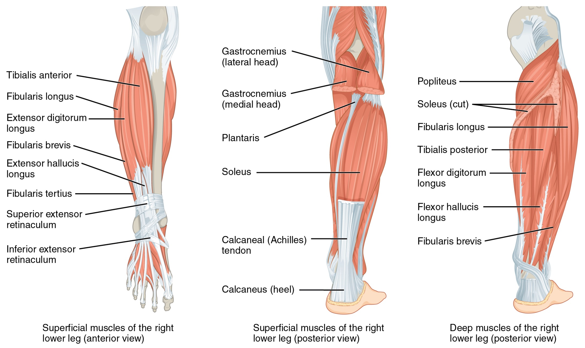

Slide 36
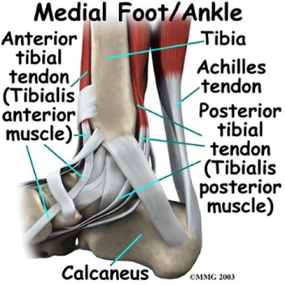
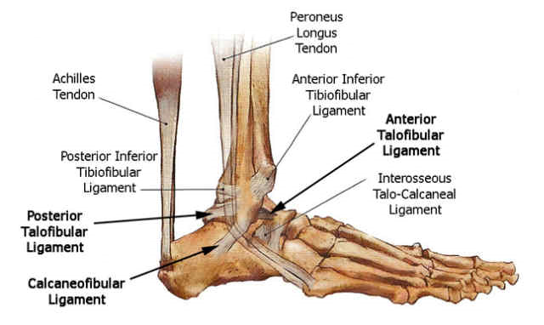
Anatomy of Ankle Joint
Hinge joint
Capsule reinforced by lateral and medial ligaments
Fibula/tibia and talus
Fibula/tibia bound together at syndesmosis by anterior/posterior tibiofibular ligaments
Talus narrower posteriorly so ankle more liable to injury when plantarflexed
Ligaments that stabilise
Inferior tibiofibular ligaments (anterior and posterior)
Attach to fibula and tibia
Lateral ligament
Originates from fibula
Most common torn
Medial ligament (deltoid)
Triangular and very strong
Originates from medial malleolus
https://www.bing.com/videos/search?q=anatomy+of+ankle&&view=detail&mid=10006EE7718CDCF046F910006EE7718CDCF046F9&&FORM=VDRVRV
https://www.bing.com/videos/search?q=anatomy+of+ankle&&view=detail&mid=8704361DD7B99A357E7B8704361DD7B99A357E7B&&FORM=VDRVRV

Slide 37
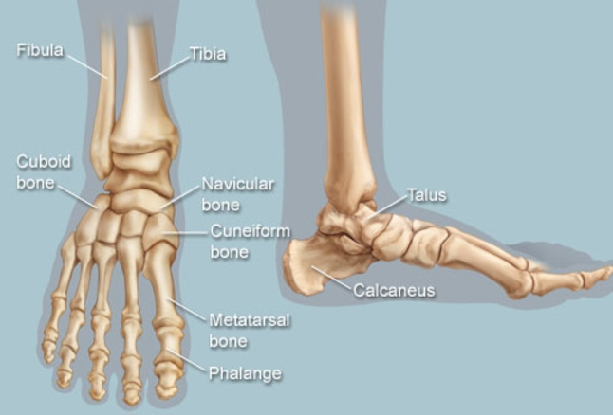
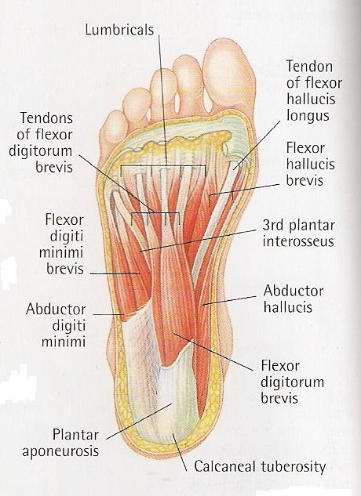
Anatomy of Foot
https://www.google.co.uk/url?sa=t&rct=j&q=&esrc=s&source=video&cd=4&cad=rja&uact=8&ved=0ahUKEwixlbDH2oHZAhWCkCwKHexGBecQtwIIODAD&url=https%3A%2F%2Fwww.youtube.com%2Fwatch%3Fv%3DROd1Acma64o&usg=AOvVaw2MPY41oQNMrEDqJbxTDB49
Calcaneus and first and fifth metatarsals form tripod on standing
Arches
Medial longitudinal arch
Bones: calcaneus, talus, navicular, cuneiformis, medial 3 metatarsals
Support: spring ligament, plantar fascia, abductor hallucis and flexor digitorum brevis, tibialis anteior, tibialis posterior, flexor hallucis longus
Lateral longitudinal arch
Bones: calcaneus, cuboid, fourth and fifth metatarsals
Support: long/short plantar ligaments, plantar fascia, flexor digitorum brevis, flexor digiti minimi, abductor digiti minimi, peroneus tertius, peroneus brevis
Anterior arch
On non-weight bearing foot
Bones: metatarsal heads
Intrinsic foot muscles
Maintain shape of foot
Interosseous and lumbrical muscles extend toes at PIP and DIP joints

Slide 38
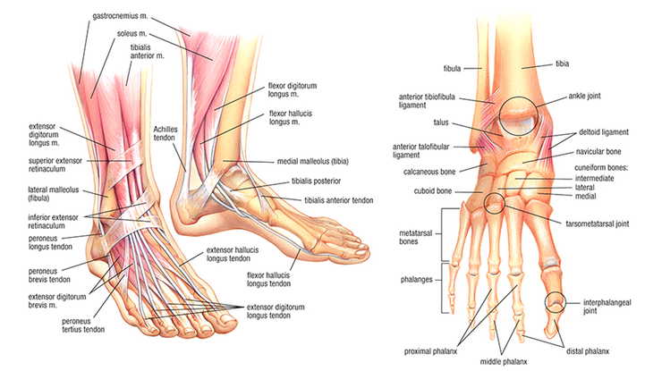

Slide 39
Other Disorders of Foot/Ankle
https://www.google.co.uk/url?sa=t&rct=j&q=&esrc=s&source=video&cd=3&cad=rja&uact=8&ved=0ahUKEwiQot602oHZAhXGDCwKHWJKACQQtwIINTAC&url=https%3A%2F%2Fwww.youtube.com%2Fwatch%3Fv%3DkdGSGofCa9I&usg=AOvVaw1ZlUC4FJ_sBcYUf4GmIQeD - EXAMINATION
Claw toes
Weakness of interosseous and lumbrical muscles resulting in unopposed action of flexor digitorum longus causing flexion of DIP/PIP joints
Cause: idiopathic, pes cavus, hallux valgus, poor footwear, RA
Tx: treat cause, exercises for intrinsic muscles, insoles, surgery (metatarsal head excision)
Hammer toes
Affects 2nd/3rd/4th toes
Hyperextension of MTP/DIP joints and flexion at PIP joints
Tx: remove cause, splinting, arthrodesis of PIP joint
Mallet toe – flexion deformity in DIP joint, tx with chiropody or joint fusion
Pes cavus (claw foot)
High longitudinal arches
Clawing caused by intrinsic muscle weakness
Causes: poliomyelitis, spinocerbellar degenerative disease (always check spine!)
Tx: insoles, surgery (lengthen achilles tendon)
RA
Deformities:
Pes planus, splay foot, hallux valgus, claw toes, anterior metatarsalgia, hammer toes
Hallux valgus
Lateral deviation of great toe
Complications: exostosis, bunion, OA, displaced/dislocated second toe
Tx: modify footwear, surgery (distal osteotomy/proximal osteotomy if severe)
Hallux rigidus
Types
Adolescent – synovitis of MTP joint post-injury
Adult – OA of MTP
Tx: stiff soled shoes, fusion of MTP joint
Metatarsalgia
Pain under metatarsal heads
Tx: shoe inserts and chiropody
Morton’s neuroma
Plantar/digital neuroma affecting plantar nerve
Requires excision
Tibialis posterior insufficiency
Causes flat foot (loss of arch)
Tx: weight loss, physio, arch supports

Slide 40
Diabetic Foot
Surgery has higher incidence of complications
Assess vascularity, sensation and skin before surgery

Slide 41
Shoulder and humerus

Slide 42
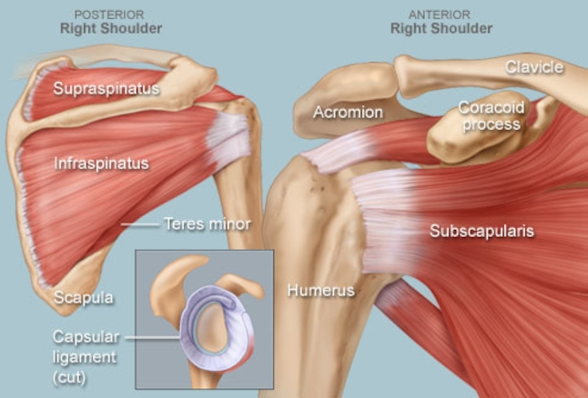
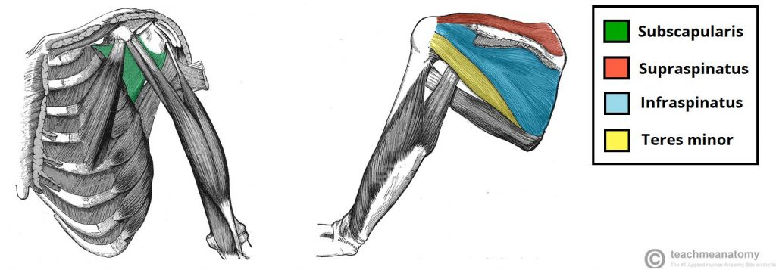
Anatomy of Shoulder
https://www.google.co.uk/url?sa=t&rct=j&q=&esrc=s&source=video&cd=3&cad=rja&uact=8&ved=0ahUKEwi87pqx34HZAhUliaYKHQfjBtAQtwIINTAC&url=https%3A%2F%2Fwww.youtube.com%2Fwatch%3Fv%3DD3GVKjeY1FM&usg=AOvVaw2l_krZfdP4MZyDzEfr1Q5e
3 joints
Glenohumeral
Scapulothoracic
Acromioclavicular
3 bones
Scapula
Humerus
Clavicle
4 ligaments
Corcohumeral
Glenohumeral – ball in socket
Transverse humeral
Coracoacromial
5 muscles
Deltoid – abducts arm (initially assisted by supraspinatus), axillary nerve
ROTATOR CUFF
Subscapularis – medial rotator, subscapular nerve
Supraspinatus – shoulder abduction, suprascapular nerve
Infraspinatus – lateral rotator, suprascapular nerve
teres minor – lateral rotation, axillary nerve
5 contributors to joint stability – limit extremities of joint movement
Glenoid labrum
Rotator cuff (tendons)
Coracoacromial arch
Long head of triceps
Capsule and ligaments

Slide 43
Surgical Approaches
Anterior approach
https://www.youtube.com/watch?v=BuQgEEfRqHs
Lateral approach
Used for rotator cuff repair
Involves splitting deltoid fibres

Slide 44
Shoulder Disorders
Many other conditions can present with shoulder tip pain
Rotator cuff pathology
Subarcomial impingement – requires steroid injections and physio
Cuff tears – caused by sudden traction, difficulty abducting arm, requires surgery (decompression of rotator cuff)
Arthritis of glenohumeral joint
Tx: physio, analgesia (shoulder replacement in very small number)
OA of acromioclavicular joint
Tx: physio, excision of distal clavicle if severe
Adhesive capsulitis (frozen shoulder)
Due to degenerative changes of rotator cuff
S: reduced ROM (especially external rotation)
Tx: physio, steroid injections, manipulation

Slide 45
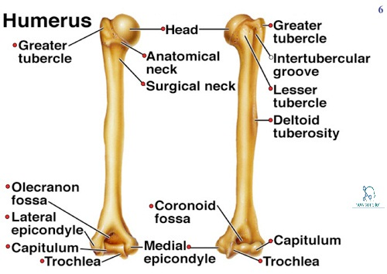
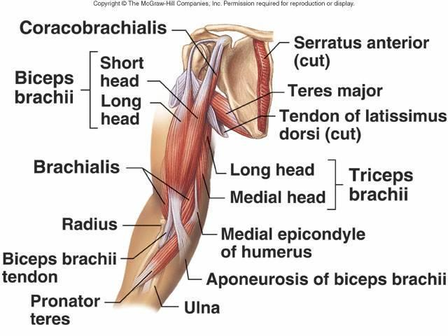
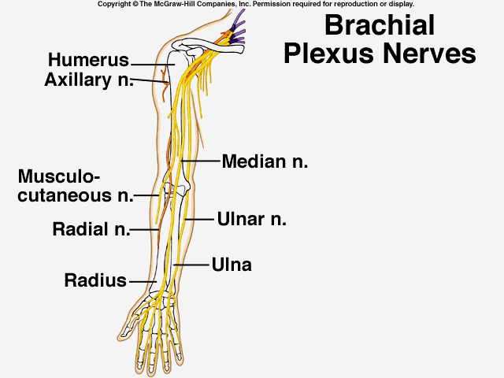
Anatomy of Upper Arm
https://www.google.co.uk/url?sa=t&rct=j&q=&esrc=s&source=video&cd=3&cad=rja&uact=8&ved=0ahUKEwiYrrqq5IHZAhVHVSwKHaprB_IQtwIINTAC&url=https%3A%2F%2Fwww.youtube.com%2Fwatch%3Fv%3DOs2zuEuGCIw&usg=AOvVaw0MQ_aURcc-JyBMG1LqMnc8
Humerus
Neurovascular relationships
Surgical neck – axillary nerve
Spiral groove – radial nerve
Posterior medial epicondyle – ulnar nerve
Muscles
Musculoskeletal nerve
Coracobrachialis – flex/adduct shoulder
Biceps brachii – flex elbow
Brachialis – flex elbow
Radial nerve
Triceps brachii – extends elbow
Anconeus – extends elbow and controls ulnar
Nerves
Axillary – supplies deltoid, teres minor, shoulder joint
Radial – gives off posterior interosseous nerve
Musculocutaneous – supplies coracobrachialis, biceps and brachialis
Median - supplies flexor compartment of forearm, thenar eminence, lateral 2 lumbricals
Ulnar – supplies intrinsic muscles
Vessels
https://www.google.co.uk/url?sa=t&rct=j&q=&esrc=s&source=video&cd=1&cad=rja&uact=8&ved=0ahUKEwjv7OrN5IHZAhXGhiwKHUYeBwAQtwIIKTAA&url=https%3A%2F%2Fwww.youtube.com%2Fwatch%3Fv%3Dr3J_bJmhlKM&usg=AOvVaw15Xf3qKnqhJmZBNko0W8fq
https://www.google.co.uk/url?sa=t&rct=j&q=&esrc=s&source=video&cd=5&cad=rja&uact=8&ved=0ahUKEwiYrrqq5IHZAhVHVSwKHaprB_IQtwIIQTAE&url=https%3A%2F%2Fwww.youtube.com%2Fwatch%3Fv%3DiDXUwErttJA&usg=AOvVaw0Iy4ORUmmSzSrvJlQfKSPl

Slide 46
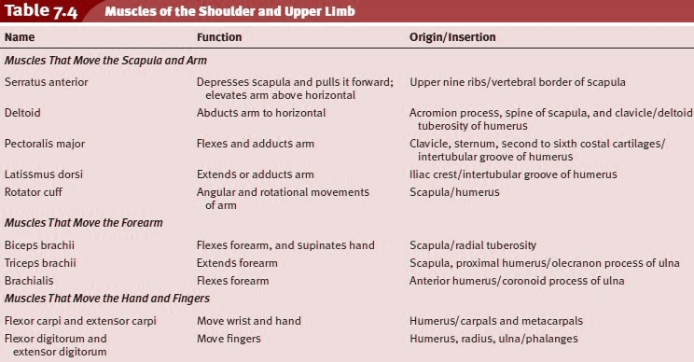

Slide 47
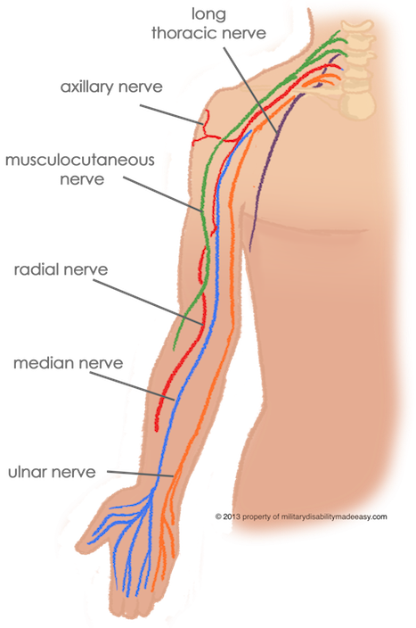

Slide 48
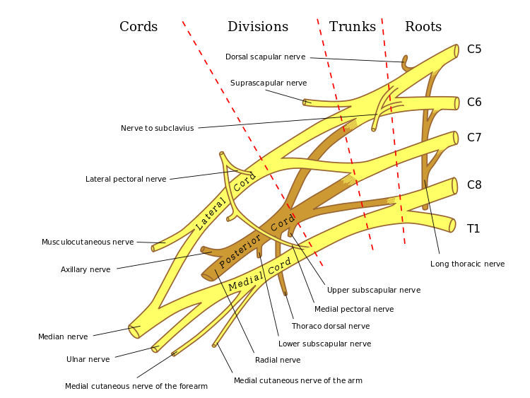

Slide 49
elbow

Slide 50
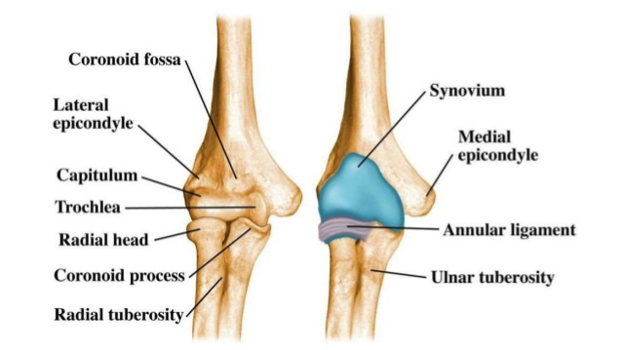
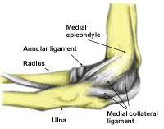
Anatomy of Elbow
https://www.google.co.uk/url?sa=t&rct=j&q=&esrc=s&source=video&cd=1&cad=rja&uact=8&ved=0ahUKEwjRlbnO5YHZAhWtiaYKHU1cDcsQtwIIKTAA&url=https%3A%2F%2Fwww.youtube.com%2Fwatch%3Fv%3DVEg2rReyM6k&usg=AOvVaw0bM0pBWWUaMkzWRvgbwtdf
https://www.google.co.uk/url?sa=t&rct=j&q=&esrc=s&source=video&cd=2&cad=rja&uact=8&ved=0ahUKEwjRlbnO5YHZAhWtiaYKHU1cDcsQtwIILzAB&url=https%3A%2F%2Fwww.youtube.com%2Fwatch%3Fv%3D3l3-5Ij3JZ8&usg=AOvVaw36ckgDBDB_nFPAasRr1EKE
Enables positioning of hand by allowing flexion and pronation/supination
3 joints
Ulnohumeral
Radiohumeral
Proximal radioulnar
Movements
Flexion/extension
Flexion by brachialis, biceps brachii, brachioradialis, pronator teres
Extension by triceps and anconeus
Pronation/supination
Pronation by pronator teres and pronator quadratus
Supination by biceps and supinator
Ossification centres of elbow (CRITOL)
Capitulum
Radial head
Internal (medial) epicondyle
Trochlea
Olecranon
Lateral epicondyle
Neurovascular relations
Median nerve and brachial artery lies medial to biceps tendon and superficial to brachialis
Radial nerve lies lateral to biceps tendon
Ulnar nerve at elbow lies behind medial epicondyle

Slide 51
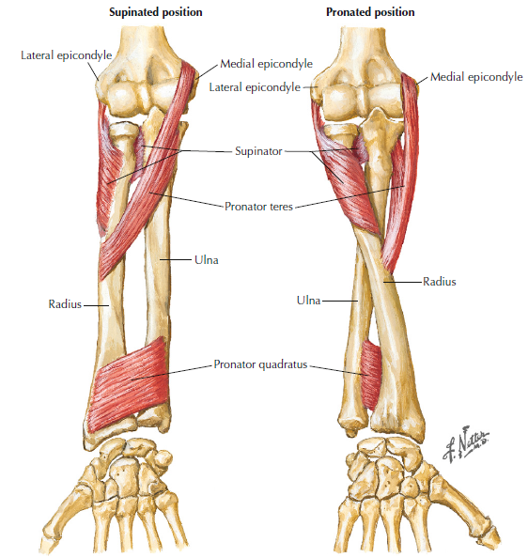

Slide 52
Surgical Approaches
To humerus
Anterior approach
Anterolateral approach – better access to distal humerus
Posterior approach – for ORIF of shaft fracture
Lateral approach
To elbow
Posterior approach – for ORIF of articular fracture
Medial approach
Anterolateral approach

Slide 53
Elbow Disorders
Tennis elbow
Small teaer in common extensor followed by inflammation
S: pain on lateral side of elbow worse on movement
Tx: steroid injections, topical NSAIDs, no evidence surgery is effective
Golfers elbow
Pain localised to medial epicondyle
Cubitus varus (decrease in angle)/valgus (increase in angle)
Post-supracondylar fracture in childhood
If interference with function, corrective osteotomy needed
Tardy ulner nerve palsy
Slow onset ulnar nerve palsy after injury to elbow in childhood
Tx: transposition of nerve to in front of joint
Ulnar neuritis/ulnar tunnel syndrome
Susceptible to compression/trauma at:
Medial epicondyle
Two heads of flexor carpi ulnaris
Ulnar tunnel of hand
Pulled elbow (nursemaids)
Dislocation of radial head in children due to sudden traction in one arm
S: limited supination and tenderness over radial head
Tx: reduce by sling/manipulation

Slide 54
Forearm and wrist

Slide 55
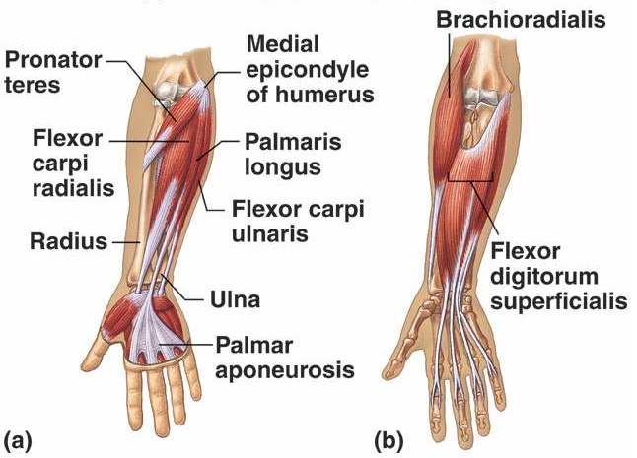
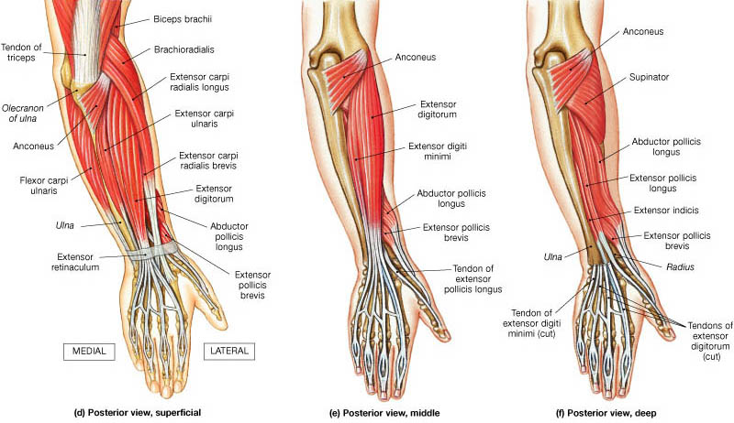
Muscles
https://www.google.co.uk/url?sa=t&rct=j&q=&esrc=s&source=video&cd=6&cad=rja&uact=8&ved=0ahUKEwi83vWPmITZAhWFWSwKHV4xBjEQtwIISDAF&url=https%3A%2F%2Fwww.youtube.com%2Fwatch%3Fv%3Dx6ug7qNVHMg&usg=AOvVaw0ypStd-WRUSg735YsVqTDp
https://www.youtube.com/watch?v=Bs2zQN9EZM8
https://www.youtube.com/watch?v=yYlzRscZ0Ko
https://www.youtube.com/watch?v=ysDqbqWOcKw
Flexors
Median nerve
Pronator teres
Flexor carpi radialis
Palmaris longus
Flexor digitorum superficialis
Anterior interosseous branch of median
Flexor policis longus
Pronator quadratus
Ulnar nerve
Flexor carpi ulnaris
Flexor digitorum profundus
Extensors
Radial nerve
Brachioradialis
Extensor carpi radialis longus
Extensor carpi radialis brevis
Supinator
Posterior interosseous branch of radial
Extensor digitorum
Extensor digiti minimi
Extensor carpi ulnaris
Abductor pollicis longus
Extensor pollicis brevis
Extensor pollicis longus
Extensor indicis

Slide 59
Bones
Radius and ulna joined by interosseous membrane
Pronation/supination → head of radius rotates against radial notch of ulna and radial shaft swings around ulnar shaft
https://www.google.co.uk/url?sa=t&rct=j&q=&esrc=s&source=video&cd=4&cad=rja&uact=8&ved=0ahUKEwiNqIifmoTZAhUMalAKHV-6ADsQtwIIOzAD&url=https%3A%2F%2Fwww.youtube.com%2Fwatch%3Fv%3DO-yQoHmcunk&usg=AOvVaw1YVQBMfk4PUnMyANtIjvtQ

Slide 60
Bones of Wrist
https://www.google.co.uk/url?sa=t&rct=j&q=&esrc=s&source=video&cd=4&cad=rja&uact=8&ved=0ahUKEwjDqKrTmoTZAhVGLVAKHSxdDwkQtwIIOzAD&url=https%3A%2F%2Fwww.youtube.com%2Fwatch%3Fv%3DFFwnASv4oOI&usg=AOvVaw2RJJA0Kz6ov11mQj4PU6UF
8 bones in 2 rows stabilised by ligaments
So Long To Pinky, Here Comes The Thumb
Scaphoid – at risk of AVN
Lunate
Triquetral
Pisiform
Hamate – articulates with 5th metacarpal
Capitate
Trapezoid
Trapezium - articulates with 1st metacarpal

Slide 61
Bones of Hand
Metatacarpals
Ligaments at MCP joints
Tight in flexion
Phalanges
Proximal
Middle
Ligaments at IP joints
Tight in extension

Slide 62
Muscles of Hand
Intrinsic

Slide 64
Palmar interossei – ADDUCT (PAD)
Dorsal interossei – ABDUCT (DAB)

Slide 65
Surgical Approaches to Forearm
To radius
Anterior
Posterior
To ulna
http://www.google.co.uk/url?sa=t&rct=j&q=&esrc=s&source=video&cd=1&cad=rja&uact=8&ved=0ahUKEwjxy9mznYTZAhXMXCwKHROcABsQtwIIKTAA&url=http%3A%2F%2Fsynthes.vo.llnwd.net%2Fo16%2FUS%2Fcourses%2Fjnj042-asa-forearm-150309%2Fplayer.html%3Fdrb%3Dsa-1&usg=AOvVaw2tynqxKVO2wm7RHyWKdtd5

Slide 66
hand

Slide 67
Movements of Fingers/Thumb
Fingers
Flexion – DIP (flexor digitorum profundus), PIP (flexor digitorum superficialis)
Extension – MCP (extensor digitorum communis), index finger (extensor digiti indicis), little finger (extensor digiti minimi), PIP/DIP (intrinsic muscles)
Abduction – dorsal interossei
Adduction – palmar interossei
Thumb
Flexion – flexor pollicis longus, thenar eminence, felxor pollicis brevis
Extension – extensor pollicus longus, extensor pollicis brevis
Abduction – adbuctor pollicis longus, abductor pollicis brevis
Adduction – adductor pollicis
Opposition – opponens pollicis

Slide 68
Injuries
Extensor tendon
Mallet finger – DIP can’t be extended, requires splinting
Mallet thumb – post-Colles’ fracture, requires surgical repair
Boutonniere – flexion at PIP and hyperextension at DIP
Swan neck – flexion at DIP, hyperextension at PIP
Flexor tendon
Described within tendon zones
Requires primary repair
Z thumb
RA
Flexed MCP and hyperextended IP

Slide 69
Infections
Paronychia
Between nail and side of finger, staph aureus
Apical infections
Top of nail and nail bed
Pulp infections
Fibrofatty tissue of fingertips, very tender
Tendon sheath infections (flexor tenosynovitis)
Staph aureus
Rapid swelling, painful and swollen flexed finger, pain on extension
KANAVELS SIGNS: tenderness over flexor sheath, pain on passive extension, flexured posture of digit, fusiform swelling of digit
Requires incision and drainage and abx
Web space infections
Swelling extending to back of hand
Requires incision and drainage and abx
Midpalmar/thenar space infections
Swelling of dorsal and palmar regions
Abx and splinting

Slide 70
Other Disorders of Hand
Rheumatoid hand
MCP and PIP
Deformity caused by tendon rupture (flexor pollicis longus), joint damage and subluxation
Tx: conservative (analgesia, rest), surgery (synovectomy, joint replacement, tendon repair, arthrodesis, physio)
De Quervains tenosynovitis
Stenosis of tendon sheath of first dorsal wrist compartment (abductor pollicis longus, extensor pollicis brevis)
Diagnosed by Finkelsteins test – making fist over thumb causes pain
Tx: rest and steroid injections
Trigger finger
Thickening of tendon sheath causing narrowing and trapping of flexor tendon
Causes triggering of finger and it is released , clicks on bending
Tx: steroid injections
Dupuytren’s contracture
Fibroplasia of palmar/digital fascia causing nodules that result in flexion contracture
Assocaited with familial, diabetes, cirrhosis
Tx: surgery if causing functional problem (fasciotomy, fasciectomy)
Complications: nerve injury, haematoma, infection, stiffness
Ganglion cyst
Herniation of fluid from joint/tendon
Transilluminate
Tx: aspiration
Dermoid cyst
Congenital
Acquired

Slide 71
Upper Limb Neuropathies
Brachial plexus injury
Erbs palsy – at birth, requires physio
Adult traction injury – RTA, requires nerve graft
Median nerve injury
supplies motor to LOAF muscles of thenar eminence and sensation to lateral palm
Lateral two lumbricals
Opponens pollicis
Abductor pollicis
Flexor pollicis brevis
Carpal tunnel syndrome – tinnels/phalens test
Pain and paraesthesia in median nerve distribution, wasting of thenar muscles, relieve pain by hanging arm out of bed
Tx: conservative with splints or surgical nerve decompression
Pronator syndrome
loss of sensation in radial 3.5 digits and pain in distal upper arm
Ulnar nerve lesions
Supplies hypothenar, interossei, two medial lumbricals and adductor pollicis in hand
Caused by ulnar tunnel syndrome, supracondylar fractures
Radial nerves injuries
Supplies skin of dorsum of hand and all extensors

Slide 72
Orthopaedic infections

Slide 73
Pathology
Commonly staph aureus
Blood borne pathogens affect areas of rich blood supply
Process
Start at metaphysis → travel through cortex → exudate deep to periosteum → subperiosteal pus → cortex infection → sequestrum (dead bone) → involucrum (new bone forming in response to infection)

Slide 74
Septic Arthritis
Invasion of a joint by microorganism
SURGICAL EMERGENCY
S: hot, painful, swollen joint, reduced ROM, spiking pyrexia
Ix: XR, USS (with aspiration), blood culture
Tx: joint aspiration, surgical washout, abx (after culture)
Complications
Early – effusion, soft-tissue swelling, muscle wasting, periarticular osteoporosis
Late – OA, stiffness, growth arrest if child

Slide 75
Osteomyelitis
Bacterial infection of bone
Staph aureus
Can lead to septic arthritis
Acute
S: pain increases in severity, bony tenderness, pyrexia, joint effusion
Ix: XR, MRI, culture
Tx: resus, abx, splintage, aspiration of collections
Complications: recurrence, chronic osteomyelitis, septic arthritis, pathological fractures, growth plate damage
Chronic
Classification: medullary, superficial, localised, diffuse
S: long bones, vertebral bones, small bones of feet; pain, inflammation, ulceration
Ix: XR (has changes), MRI, cultures
Tx: identify organism, abx (2 week IV, 4 week PO)

Slide 76
TB of Skeleton
Mycobacterium tuberculosis
Haematogenous spread from infection in lymph nodes
Commonly affects thoracic spine
S: pain, stiffness, deformity, systemic symptoms, synovial thickness
Ix: ZN staining (thin rods, acid fast bacilli), CXR (primary lesion), XR, MRI, biopsy for staining
Tx: chemo (RIPES), debridement, drainage, reconstruction
Rifampicin (hepatitis, discolour fluids),
Isoniazid (hepatitis, neuritis)
Pyrazinamide (arthralgia)
Ethambutol (optic neuritis, peripheral neuropathy)
Streptomycin (nephrotoxicity, ototoxicity)
Risk of spinal cord compression

Slide 77
Neoplasia

Slide 78
Principles
History
Pain, swelling, loss of function, incidental finding
Radiology (do before biopsy)
Look for bone response to tumour
Biopsy
FNA, core, excisional
Staging
Spread, histology,
Enneking (G0 – benign, G1 – low grade, G2 – high grade)
Aim of surgery
Remove tumour and prevent recurrence
Resection/amputation

Slide 79
Primary Malignant
Rare
Types:
Myeloma
Most common
Any bone
Proliferation of B cells
Ix: plasma electrophoresis and urinanlysis (Bence Jones proteins), bone marrow biopsy definitive
S: fatigue, weakness, pain
Tx: surgery, radiotherapy, bone marrow transplant
Osteosarcoma
Aggressive and metastasising
Medullary cavity in metaphyseal ends of long bones (distal femur, proximal tibia)
Malignant osteoblasts produce osteoid
S: painful enlarging mass
Ix: spiral CT (pulmonary mets)
Tx: chemo and surgery
Chondrosarcoma
Primary/malignant transformation of cartilage tumour
In medulla of bone or on bone surface
S: pathological fracture
Tx: resection
Ewings tumour
Children
Diaphysis of long tubular bones (femur)
Translocation chromosomes 11 and 22
Ix: moth eaten, onion skin
Tx: resection and chemo

Slide 80
Benign Tumours
Osteochondroma – most common, bony stalk with cartilage cap
Echondroma – hyaline cartilage within long bone
Juxtacortical chondroma - rare
Chondroblastoma – hyaline cartilage
Chondromyxoid fibroma - rare
Osteoid osteoma – bone forming tumour that may heal spontaneously/aspirin
Osteoblastoma – osteoid osteoma in spine
Bone island
Bone infarct
Bone cyst (aneurysmal, unicameral)
Giant cell tumour
Haemangioma

Slide 81
Skeletal Mets
Cause pathological fractures
Tumour spreads via direct/lymph/vascular/intraspinal
Common: prostate, breast, lung, kidney, throid (5 B’s)
In children: neuroblastoma, Wilms tumour
S: pain, hypercalcaemia, fractures, neuro complications, marrow suppression (anaemia)
Ix: XR, bone scans, CT, MRI, identify primary!
Tx: meds (radio, bisphosphonates), surgery (for pathological fractures, prophylactic stabilisation of impending fractures, spinal decompression, reconstruction)

Slide 82
spine

Slide 83
Development
Neural plate folds to form neural tube at 4 weeks; closure begins centrally
Failure of closure cranially causes anencephaly and spinally causes spina bifida
Vertebrae develop from mesodermal somites and ossify at week 8 from 3 primary ossification centres
https://www.youtube.com/watch?v=-l4qrBxhpsc

Slide 84
Function
Structure – maintain posture, locomotion
Protective – spinal cord/nerve roots
Haematopoeisis – red marrow found in axial skeleton

Slide 85
Anatomy
Spinal curves
Cervical and lumbar = lordotic
Thoracic and sacrococcygeal = kyphotic
Bones and joints
33 vertebrae (24 mobile (7 C, 12 T, 5 L), 9 immobile (5 S, 4 coccygeal)
Joined by intervertebral discs
Annulus fibrosus and nucleus pulposus
Moving the spine
Ligaments
Vertebral bodies joined by anterior and posterior longitudinal ligaments
Others: ligametnum flavum, supraspinatus, interspinous, ligamentum nuchae, intertransverse ligaements
Muscle groups
Superficial extrinsic – trapezius, latissimus dorsi, levator scapulae, rhomboid major and minor
Intermediate extrinsic – serratus posterior superior and inferior, lavatories costorum
Intrinsic
Superficial intrinsic – splenius capitus, splenius cervicis
Intermediate intrinsic – iliocostalis, longissimus, spinalis
Deep intrinsic – transverse spinalis (semispinalis, multifidus, rotatores)
Nervous structures
Blood supply

Slide 86
Cervical Vertebrae
Immediately inferior to skull
Distinguished from thoracic or lumbar vertebrae by presence of a hole in the transverse process
Have hole in transverse process (foramen transversarium) for vertebral artery and vein
C1 – ring with no spinous process
C2 – odontoid peg
Special joints:
Atlanto-occipital - nodding
Atlantoaxial - rotate head

Slide 87
Thoracic Vertebrae
Typical
Heart shaped verterbral body
3 sites on each side for articulation with ribs; 2 demifacets (superior costal facet articulates with part of head of its own rib whereas inferior costal facet articulates with part of the head of the rib below) and an oval facet (transverse costal facet – articulates with the tubercle
Atypical
T1 = head of rib 1 doesn’t articulate with C7
T10 = only articulates with its own ribs so lacks inferior demifacets
T11 + T12 = articulate only with heads of their own ribs

Slide 88
Lumbar Vertebrae
Five vertebrae behind rib cage and pelvis
Absence of foramen transversarium within the transverse process and facets at the side of the body

Slide 89
Sacrum
Transmits body weight to pelvic gridle

Slide 90
Ligaments

Slide 91
Superficial Extrinsic Back Muscles
https://www.youtube.com/watch?v=cqr7UcXX1Fo

Slide 93
Intrinsic – superficial
https://www.youtube.com/watch?v=rLugy7OjSb4
Superficial:

Slide 94
Intrinsic – intermediate

Slide 97
Suboccipital Triangle
Between skull and posterior atlas
Deep to trapezius
4 muscles:
Rectus capitis posterior minor and major
Superior and inferior oblique

Slide 99
Nervous Structures
Spinal cord
Dura → subdural space → arachnoid → subarachnoid space → pia
Enlargements
C4-T1 – forms brachial plexus
L2-S3 – forms lumbar plexus
Tapers to conus medullaris
LP occurs at L4
https://www.youtube.com/watch?v=R2_0gOI8uV0
Complications – headache, nerve root trauma, minor bleeding, coning (herniation), infection
Spinal nerves
31 pairs from each nerve root (ventral and dorsal root nerves unite to form spinal nerve)

Slide 100
Brachial Plexus
https://www.youtube.com/watch?v=gTas7ijp0YE

Slide 102
Lumbar Plexus
https://www.youtube.com/watch?v=h1uzz9LQXKQ

Slide 103
Spinal Nerves

Slide 104
Defintions
Dermatome = Area of skin supplied by single spinal nerve
Myotome = segmental innervation of skeletal muscles

Slide 107
Autonomic Nervous System
Innervates involuntary structures
Sympathetic
FLIGHT/FIGHT
Increased HR and BP, blood diverted from skin and gut by vasoconstriction and diverted to brain and skeletal muscle, pupils dilate
Route
Ventral root → spinal nerve → primary ramus → sympathetic ganglion → ascend/descend in sympathetic trunk → postganglionic fibres → ventral rami
https://www.youtube.com/watch?v=zDT4f0TKj3k
https://www.youtube.com/watch?v=0NBS71TuaCo
Parasympathetic
Opposite effect of sympathetic

Slide 109
Blood Supply to Spinal Cord
Arterial
Descending posterior spinal arteries (from vertebral arteries)
Descending anterior spinal artery
Radicular arteries
Artery of Adamkiewicz supplies lower 2/3’s spinal cord
Veins
Drain to internal vertebral venous plexus

Slide 111
Pathology of Spine
Spondylosis
Progressive, degenerative changes, affecting lower lumbar
Nucleus pulposus loses water and flexibility causing annulus fibrosus to herniate
S: pain, motor loss
Disc prolapse
Prolapse of intervertebral disc due to degeneration causing herniation of nucleus pulposus
Herniation can compress spinal cord or impinge on nerve roots
Tx: rest, physio, surgery if neurological symptoms
RA
Affects C1/C2
S: pain to vertex of skull, spinal cord compression (numb hands)
Ankylosing spondylitis
HLA-B27
Affects sacroiliac joints
S: low back pain better on exercise, stiffness, deformity, achilles tendon rupture, iritis, aortitis, high ESR
Tx: analgesia, physio, vertebral osteotomy
Spinal infections
Tumours
Mets – cause vertebral collapse, cauda equine; 6 B’s (breast, brostate, bridney, bronchus, byroad, bladder)
Primary – of v=bone, covering layers, spinal cord
Osteoporosis/fractures

Slide 112
Lower Back Pain
Causes
Mechanical (non-specific)
Irritation of facet joints
Dull aching pain worse on activity
Rest, analgesia, physio, steroid injections
Nerve root pain (radiculopathy/sciatica)
Disc protrusion/SOL (tumour, RA, osteophytes)
Dermatomal sensory loss, muscle weakness and reflex loss
Rest analgesia, physio, may require further MRI
Spinal cord compression
Central disc protrusion/trauma/tumour/AnkSpond/Pagets
Numbness, weakness of legs, reduced bladder control
Urgent MRI and surgical decompression
Cauda equina
Compression of cauda equine (disc rupture)
Sphincter disturbance (incontinence, saddle anaesthesia, motor weakness, low back pain, sexual dysfunction)
Requires surgery
Neurogenic claudication
Spinal stenosis
Vague backache, morning stiffness, ache in legs when standing, paraesthesia on exercise
Tx: surgery
Coccodynia
Coccygeal pain
Tx: physio, steroid injections

Slide 113
Surgical Management of Lumbar Spine
Surgical decompression (relieve pressure)
Microdiscectomy – remove herniated disc fragments
Laminectomy – remove spinous processes
Intradiscal extracanalicular approaches – decompression with minimal intervention
Fusion of lumbar spine
If deformity
Disc replacement
Avoids fusion

Slide 114
Neck Pain
Acute cervical disc prolapse
Pressure on nerve roots
Pain, paraesthesia, weakness
Analgesia, muscle relaxants, physio, requires MRI if signs of cord compression
Cervical spondylosis
Age related degenerative disease affecting C5-7
Pain, stiffness, radiculopathy
Ix: XR (loss of disc height)
Tx: surgery if recurrent
RA
Affects C1/C2
Restriction of neck movements
Tetraplegia pain
Tx: traction and fusion
Risk of SCC, nerve root compression

Slide 115
Spinal Deformity
Commonly in thoracic spine
Types
Kyphosis
Increased forward curvature
Postural/osteoporosis/senile/pathological
Scoliosis
Lateral curvature of spine
Structural/non-structural
Idiopathic
Surgery if excessive curvature
Spondylolisthesis
Forward translation of one vertebra relative to another
Meyerding grading system
Low back pain radiating to buttocks
Tx: fusion
Spinal dysraphism (neural tube defects)
Failure of neural tube development
Spina bifida cystica
Myelomeningocele
Meningocele
Spina bifida occulta

Slide 116
Complications of surgery

Slide 117
General Complications
Risks of anaesthesia
Surgery
Mortality
MI
Bleeding
DVT/PE – orthopaedic is high risk due to immobility, prolonged surgery; requires prophylactic LMWH/TEDs
Reaction to bone cement
Fat embolism syndrome

Slide 118
Local Complications
Soft tissue swelling – avoid by elevating limb in surgery, early mobilisation
Haematoma – avoided by use of suction drains (no evidence), meticulous haemostasis
Infection – due to implants (immune cells can’t infiltrate implant)
Bacteria can cause low grade infection (biofilm) around implant which is difficult to manage with abx
Theatre requries laminar flow to reduced level of particulate matter that can infect site
Always give prophylactic abx with implants
Neurovascular damage
Non-union
Malunion
Periprosthetic fracture
Implant failure
Chronic pain
Loss of function

Slide 119
Common orthopaedic problems in children

Slide 120
Limping Child
Multiple causes
Transient synovitis (irritable hip)
Due to URTI
Fever, pain and limp that self resolves
Developmental hip dysplasia
Mild dysplasia → irreducible dislocatin
Risk if breech
Tests: Ortolani’s, Barlows
Tx: splintage if dislocating with Pavlik harness, monitor with USS, if >6 months, open reduction, if >8 years, plan for total hip replacement later in life
Perthes’
Idiopathic osteonecrosis of proximal femoral epiphysis
Limp and pain
Tx: surgical intervention if present >8 years
SUFE
Displacement of upper femoral epiphysis from femoral neck
RF: obesity
S: knee pain, externally rotated and shortened leg
Tx: Pin with hip screw
Other
Arthropahy, - JIA (diagnosis of exclusion
Trauma, fracture,HSP

Slide 121
Foot Problems
Congenital talipes equinovarus (club foot)
Newborn holds foot in plantar flexion and inversion
Tx: corrective non-surgical treatment (serial casting with Ponseti technique)
Talipes calcaneus
Dorsum of foot lies against shin
Flat feet (pes planus)
Loss of medial longitudinal arch
Determine underlying cause

Slide 122
Rotational Deformities
Genu varum
Persistent varus past newborn stage suggests pathology (anything that affects bone growth – deficiency/trauma etc)
Genu valgum
Persistent valgus caused by dysplasia, infection, neoplasia
Valgus – distal bone deviates LATERALLY
Will correct with growth
In-toeing
Causes: genu valgum, internal tibial torsion, metatarsus adductus

Slide 123
Knee Problems
Patellar instability
Stability achieved by bony stability, static structure (tendon), dynamic stability
Tx: restore knee function, requires surgery if recurrent
Anterior knee pain
Due to patella maltracking, in young females
Discoid lateral meniscus
Clicking/instability
Osteochondritis dissecans of knee
Affects lateral portion of medial femoral condyle
Ix: MRI
Tx: analgesia, modified activity, stabilise with pins if loose fragments
Osgood-Schlatter disease
Traction apophysitis of tibial tubercle
Point tenderness of tibial tubercle
Tx: modified activities, stretching and quad strengthening
Sinding-Larsen-Johansson syndrome
Traction apophysitis of distal patellar pole/tears in proximal patellar tendon
Point tenderness over distal patellar pole
Tx: as for osggood

Slide 124
Metabolic Bone Disease
Rickets – see bone pathology
Skeletal dysplasia
Cause short stature/dwarfism
Achondroplasia
Normal intelligence
Delayed development of motor skills
Osteogenesis imperfecta
Mutation in gene coding for type 1 collagen
May have blue sclera (type 1 – autosomal dominant)

Slide 125
Other Problems
Obstetric brachial plexus palsy
RF: breech, shoulder dystocia
Types:
Erb-duchenne – damage to C5/C6 nerve roots, causes waiters tip deformity
Klumpke’s palsy – damage to C8-T1 nerve roots
Tx: physio and specialist care, surgery (nerve grafting)
Cerebral palsy
Fixed non-progressive brain lesion that occurs during development and maturation of brain
Mild → severe
Causes: prenatal (alcohol, drugs), encephalitis), prematurity, trauma, asphyxia
Tx: education, mobility, surgery (to control spastic deformity)

