Slide 1
Vascular Surgery

Slide 2
Overview
Vascular disease includes:
Arterial disease – occlusive, aneurysm, carotid, trauma
Venous disease – thromboembolic, varicose veins, leg ulcers
Lymphatic disease
Miscellaneous – amputations
Arterial interventions are performed to improve arterial flow and prevent vascular catastrophe

Slide 3
INVESTIGATING VASCULAR DISEASE

Slide 4
Vascular Investigations
General – bloods
Specific
ABPI - >1.1 (calcified veins), 0.7-0.9 (mild ischaemia), 0.4-0.7 (moderate iscahemia), <0.4 (critical ischaemia)
Duplex USS – assess arterial blood flow, monitor AAA/renal disease/venous disease, diagnose DVT
Grey scale
Doppler
Contrast angiography – emergency assessment of vascular crises
Digital subtraction angiography – enhances imaged from contrast angiography
CT/MRI angiography
Venography – assess venous system, has been replaced by doppler USS
Lymphoscintigraphy to look at lymphatics

Slide 5
ANEURYSMS

Slide 6
Overview
Aneurysm = pathological dilatation of an artery to >1.5 times its original diameter
Usual cause = atherosclerosis
Usually affects tunica media
Complications = rupture/leak/embolise
AAA = surgery if >5.5cm

Slide 7
Arterial Anatomy
Types of artery:
Elastic – aorta; expand to take forward flow of systole and use stored energy to recoil in diastole; high amount of elastin and collagen
Muscular – femoral artery; media thins down to few layers to become arterioles; many smooth muscle cells
Layers of an artery:
Tunica intima – innermost layer; endothelial cells; coagulation and vasomotor tone
Tunica media – middle layer; elastin and collagen fibres with vascular smooth muscle cells; vasomotor tone and structural protein synthesis
Tunica adventitia – outermost layer

Slide 8
Anatomy of Aorta
Components
Thoracic (30% elastin)
Ascending
Starts at aortic valve
Contains Valsalva sinuses – give rise to left and right coronary arteries
Aortic arch
Starts behind right side of sternum
Gives rise to brachiocephalic/left common carotid/left subclavian arteries
Ends at T4
Descending
Posterior mediastinum
T4→ T12
Branches to pericardium, lungs, bronchi, oesophagus, intercostals
Abdominal (20% elastin)
Enters abdomen through diaphragmatic crura
Bifurcates at L4 into common iliac arteries
Branches:
3 paired – adrenal, renal, gonadal
3 unpaired – coeliac, SMA, IMA

Slide 9
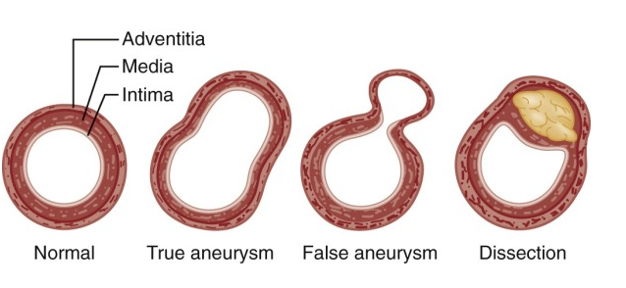
Pathology of Aneurysms
Laplace’s law = any increase in vessel diameter will increase wall tension, causing continued artery dilatation and eventual rupture
Classification
True aneurysm – involves all layers of arterial wall
Fusiform (spindle shaped)
Saccular (bag like)
False aneurysm – pulsatile, expansile swelling due to defect in an arterial wall; blood surrounds arterial lumen and compresses it
Causes
Atherosclerosis – affects tunica media
Inflammatory – inflammation in aneurysm wall, resulting in adhesions to nearby structures (duodenum) and fibrosis
Congenital – berry aneurysms linked to PCKD
Mycotic – infected needles (IVDU)
Infective – syphilis
Traumatic
CTD – Marfans

Slide 10
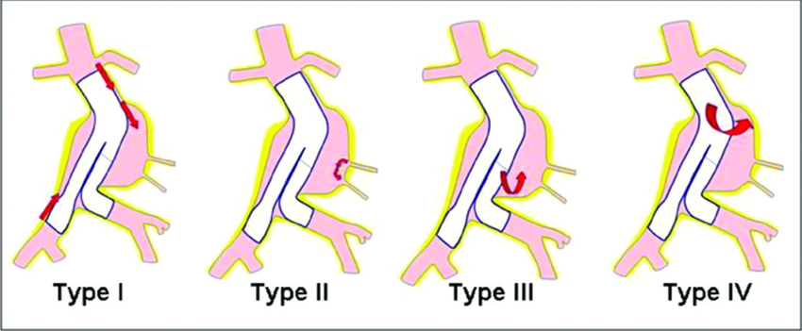
AAA
Expands → rupture (size biggest risk factor for rupture)
Commonest site = infrarenal abdominal aorta
RF: smoking, high cholesterol
S: incidental finding on imaging, central pain radiating to back, rupture (hypotension, pain, bruising in flanks), shock, embolization (thrombus from aneurysm can cause acute limb ischaemia)
if symptomatic – needs urgent repair, cause of death
Screening: 65 year old males get one off USS and if >5.5cm, offered surgical repair and if <5.5cm, monitor with repeat USS
Tx: graft/endovascular stenting (requires CT prior to surgery) – OPEN/EVAR
Complications:
Immediate – haemorrhage, distal embolization
Early – haemorrhage, MI, renal failure, DIC, ARDS, DVT/PE
Late – graft infection, aortoenteric fistula, anastomotic aneurysm
Specific EVAR complications:
Endoleak
https://www.youtube.com/watch?v=j9aK2ECcFEY

Slide 11
Peripheral Aneurysms
Popliteal
Expansile swelling, distal emboli (peripheral ischaemia), rupture is rare
Diagnosed on USS
Tx: surgical repair via ligation and vein bypass graft/endovascular stenting
Femoral
Commonly false
Asymptomatic and rarely rupture
Tx: surgical repair via insertion of prosthetic graft/reversed saphenous vein
Difficult to treat if due to IVDU and infected
Iliac
Associated with AAA
Visceral artery
Splenic
S: asymptomatic, left upper quadrant pain
Ix: signet ring calcification in LUQ on XR
Tx: ligation, resection, embolization, stenting

Slide 12
LOWER LIMB ISCHAEMIA

Slide 13
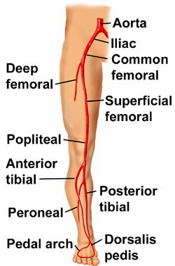
Anatomy of Lower Limb Arteries

Slide 14
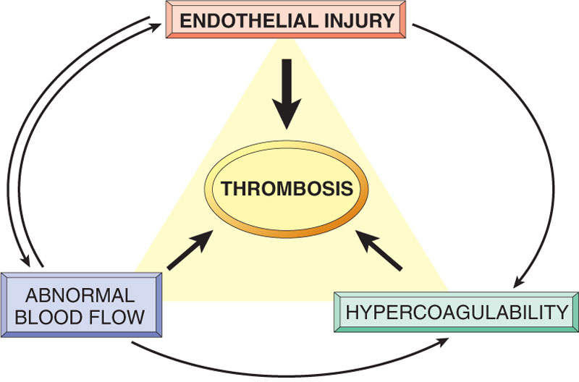
Pathology of Peripheral Vascular Disease
PVD = occlusive vascular disease in limbs
Causes: atherosclerosis with thrombosis, vasculitis, CTD
Atherosclerosis
Intimal accumulation of lipids and fibrous tissue
Plaque beneath endothelium
Fatty streak composed of lipids which develops into plaque via two hypotheses
RESPONSE TO INJURY HYPOTHESIS – intimal damage leads to monocyte and platelet adhesion to lumen and migration into vessel intima → PDGF release → promotes smooth muscle migration to developing plaque and monocytes consume lipids to form foam cells
MARCOPHAGE HYPOTHESIS – lipids collect in macrophages which breakdown to form lipid rich pool to propagate disease process
RF: smoking, HTN, diabetes, hyperlipidaemia
Complications of plaques
Thrombosis – solid mass of blood constituents (platelets, fibrin, RBC) in vasculature; development dependant of Virchows triad; secondary to atheroma in arteries/venous stasis in veins
Embolism – mass of material within vasculature that block lumen; most derived from thrombus
Ie PE
Vasculitides
Inflammatory disorders of blood vessels
See finals note
Buergers disease – obliteration of distal arteries in young men who smoke heavily
GCA – affects temporal arteries; headache and temporal tenderness; give steroids
Takayasu’s arteritis – ischaemic symptoms in upper limb

Slide 15
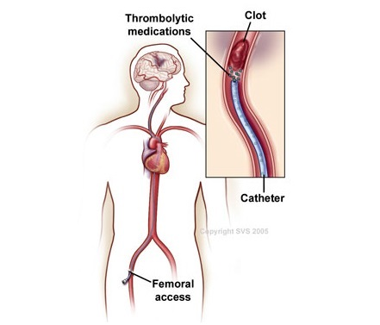
Acute Limb Ischaemia
Surgical emergency
Causes: embolus, acute on chronic thrombosis, trauma, aortic dissection
S: pain, pallor, paraesthesia, perishingly cold, paralysis, pulseless
Tx: resus, anticoagulation, surgery (thrombolysis/embolectomy/arterial bypass/reperfusion), long term management includes long term anticoagulation and arteriography to look for other sources of emboli
Embolectomy https://www.youtube.com/watch?v=2WK4Mt__CYs
Complications:
Reperfusion injury – body releases lots of metabolism products, causing oedema/rhabdomyolysis/renal failure
Compartment syndrome – lower legs have lateral/anterior/posterior compartments, requires urgent fasciotomy

Slide 16
Chronic Lower Limb Ischaemia
Causes: atherosclerosis
Common sites: aortic bifurcation, common iliac bifurcation
RF: smoking, diabetes
S: pain (intermittent claudication → rest pain, skin ulceration → gangrene)
Ix: ABPI
Tx: medical management then surgery
Correct risk factors, antiplatelets, BP control, vasodilators (nifedipine)
Interventional radiology (angioplasty – balloon inserted via cathter and inflated across stenosis/stenting – expandable metal prothetics) or surgery limited to critical limb ischaemia
Surgery
Grafts – either replace diseased region with graft or use graft to divert blood to ischaemic area VIDEO
Complications:
Early – haemorrhage, infection, DVT
Late – graft thrombosis, false aneurysm

Slide 17
Amputations
Indications
Dying tissue (vascular disease, gangrene)
Dangerous (tumour, severe infection)
Damned nuisance (useless, painful limb, neurological damage)
Levels
Needs to be proximal enough for good healing, but more distal amputations have better recovery
Eg hip disarticulation, above knee, supracondylar, through knee, below knee, syme’s, transmetatarsal, toes
Stump
Heals by primary intention
Is freely mobile
Has good soft tissue cover over bone end
Conical shape
Has mobile joint above amputation level
Does not transmit pressure through scar
Complications
Early – haemorrhage, infection, wound dehiscence, ischaemia, DVT
Late – pain (phantom limb), chronic infection, ulceration of stump

Slide 18
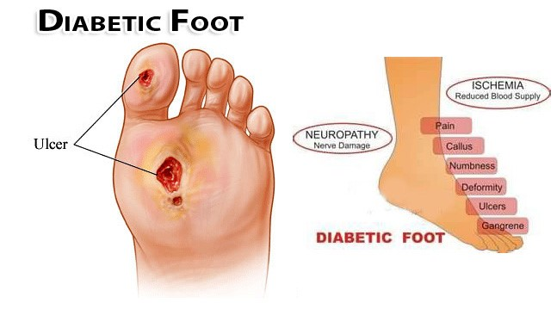
Diabetic Foot
Combination of:
Atherosclerosis – accelerated in diabetes
Peripheral neuropathy – affects motor, autonomic and sensory nerves
Impaired tissue metabolism
Infection
Management
Education
Skin and nail care

Slide 19
CAROTID ARTERY DISEASE

Slide 20
Carotid Anatomy
Common carotid
From brachiocephalic trunk (right) and arch of aorta (left)
Ends at C4
Divides in carotids
External carotid – supplies face
Branches:
From front – superior thyroid/lingual/facial
Deep medial – ascending pharyngeal
From behind – occipital/posterior auricular
Terminal – superficial temporal/maxillary
Internal carotid – supplies cranial and orbital cavity
Contains carotid sinus (baroreceptors)
Circle of Willis – supplied by ICA and basilar artery

Slide 21
Physiology of Cerebral Circulation
Regulation
Myogenic mechanisms – maintain perfusion over wide pressure range; increased pressure causes increased wall tension leading to smooth muscle contraction in vessel walls (constriction)
Metabolic mechanisms – cerebral vessels sensitive to changes in PaCO2 (increases in co2 cause vasodilation)
Measuring cerebral blood flow
Fick principle ?????

Slide 22
Carotid Artery Stenosis
Causes:
Atherosclerosis at carotid bifurcation (thrombosis/emboli)
Intracerebral haemorrhage
Subarachnoid haemorrhage
S: asymptomatic, amaurosis fugax, TIA, stroke
Ix: duplex doppler USS, CT, angiography (rule out embolism, hypercoagulation, vasculitis, SOL)
Tx:
Surgery (carotid endarterectomy)
Carotid angioplasty and stenting – under clinical trials; risk of dislodging soft thrombus causing microemboli

Slide 23
Other Carotid Pathology
Carotid body tumours
S: mass in neck adjacent to hyoid bone which is smooth, compressible and pulsatile, “potato tumours”, mobile horizontally but not vertically, have bruit,
Tx: excision
Carotid artery dissection – requires anticoagulation and surgical repair with graft if does not resolve
Carotid artery aneurysms
S: pulsatile mass, pain, Horners syndrome, CN dysfunction, cerebral ischaemia
Fibromuscular disease
Looks like string of beads on angiography

Slide 24
VASCULAR DISORDERS OF THE UPPER LIMB

Slide 25
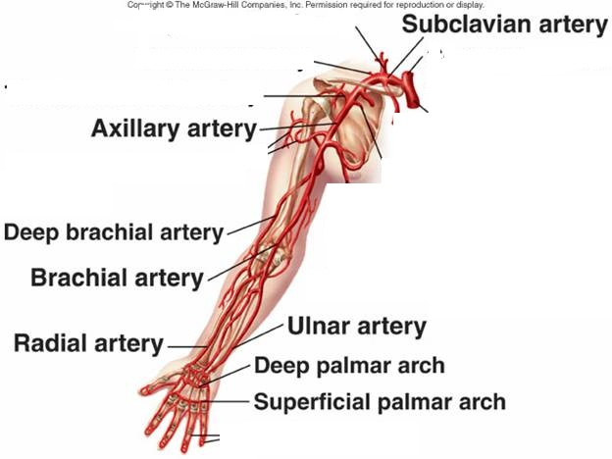
Anatomy of Vessels
Thoracic inlet
Subclavian artery
Axillary artery
Brachial artery
Ulnar artery
Radial artery
Upper limb veins

Slide 26
Atherosclerotic Disease of Upper Limb
Occlusive disease
Confined to larger vessels in upper limb
Tx: angioplasty, stenting, bypass grafting, subclavian transposition
Aneurysmal disease
Require surgical management
Embolic disease
Arise from cardiac source and lodge in brachial artery
Tx: resus, anticoagulation, identify embolus via duplex USS, embolectomy

Slide 27
Raynaud Syndrome
Episodic extreme digital vasospasm, precipitated by cold
Digital blanching due to arterial spasm (white) → cyanosis due to stagnant anoxia (blue) → reactive hyperaemia due to accumulation of vasoactive metabolites (red)
Can progress to ulceration, gangrene and digital amputation
Causes:
Idiopathic (raynauds disease)
CTD (scleroderma, RA, SLE)
Buergers disease
Tx: symptomatic, nifedipine, sympathectomy in extreme cases

Slide 28
Hyperhidrosis
Excessive sweating
Causes:
Primary – childhood/familial
Secondary – hyperthyroidism, phaeochromocytoma
Tx:
Conservative (iontophoresis)
Surgical (skin excision, sympathectomy)

Slide 29
Thoracic Outlet Syndrome
Compression of subclavian vessels
70% bilateral
Causes:
Cervical rib
Muscle hypertrophy
Callus from old clavicle fracture
Malignancy
S: emboli (ischaemic), venous (swollen, tender, warm), neurological (pain, paraesthesia, weakness), Roos’ test (abduction and external rotation precipitates symptoms)
Tx: physio, surgical decompression

Slide 30
Upper Limb Venous Occlusion
Occurs in venous drainage of upper limb
Much less common than DVT
S: painful, swollen, tender, warm arm
Tx: anticoagulation

Slide 31
Arteriovenous Malformation and Vascular Access Surgery
AV fistula = abnormal connection between arterial and venous systems
Congenital – often enlarge during puberty
Cirsoid aneurysm
Parkes-Weber syndrome
Klippel-Trenaunay syndrome
Acquired
Traumatic – thrill and bruit; requires surgical closure
Surgical (for dialysis) – can remain indefinitely; causes dilated vein which is suitable for repeat cannulation;

Slide 32
VENOUS/LYMPHATIC DISORDERS OF LOWER LIMB

Slide 33
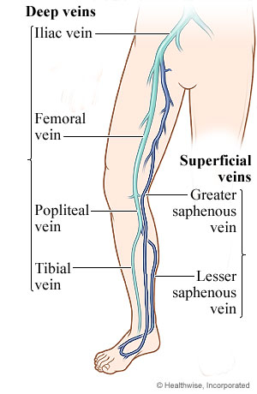
Venous Anatomy
Deep
Posterior tibial
Anterior tibial
Peroneal
Soleal – muscular vein
Gastrocnemius – muscular vein
Politeal – formed from above 5 veins
Superficial femoral vein – from popliteal
Deep femoral vein
Iliac veins
Superficial – in subcutaneous tissue, become varicose veins
Long saphenous
Short saphenous
Communication between deep and superficial
Saphenofemoral junction
Mid-thigh perforating veins
Calf communicating veins

Slide 34
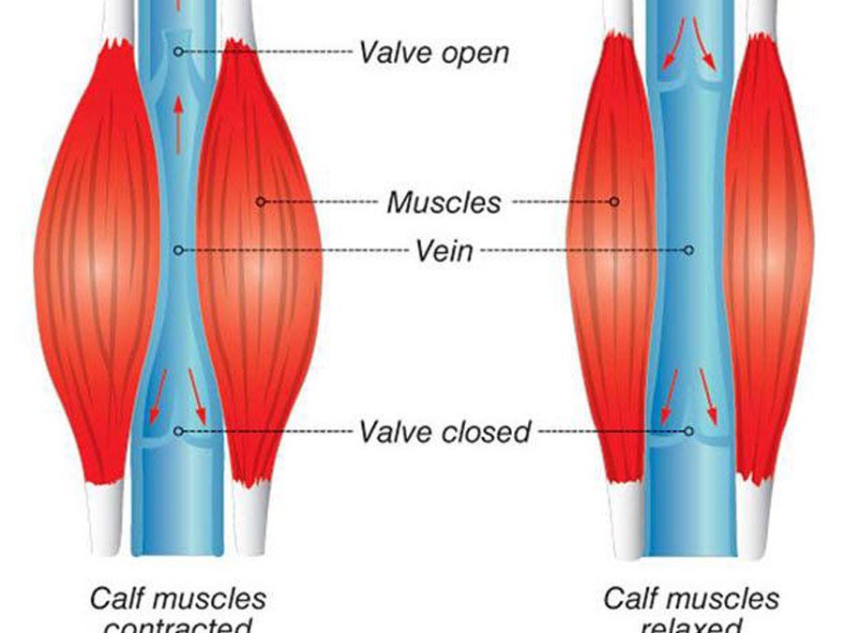
Physiology
Venous return maintained by
Heart
Calf muscle pump
Venous valves – prevent reverse flow
Venomotor tone – smooth muscles within vein
Respiratory movements – when intrathoracic pressure increases, venous return decreases and decreases CO (Valsalva)

Slide 35
Varicose Veins
Dilated, tortuous, elongated superficial veins
Causes
Primary – gravitational venous pooling and vein wall laxity causing venous dilatation and valve leakage; starts at saphenofemoral junction
Secondary - DVT, pelvic malignancy; outflow obstructed/valves are incompetent forcing blood from deep to superficial system
Common in long saphenous system
S: asymptomatic, cosmetic, ache, itch, ankle swelling, thrombophlebitis (painful inflamed varicosities), varicose eczema, lipodermatosclerosis, ulceration
Ix: duplex scanning
Tx: conservative (stockings, sclerotherapy for small varicosities), surgery (open surgery, EVLT, radiofrequency ablation

Slide 36
Other
Leg ulcers
Venous/arterial/neuropathic/trauma/malignancy (most are mixed)
Ix: duplex doppler USS, ABPI (>0.9)
Tx (venous): compression stockings,
Lymphoedema
Accumulation of tissue fluid in extracellular space due to lymph failure
Causes:
Primary - congenital
Secondary – post-radio, malignancy, infection
Ix: lymphoscintigraphy
Tx: elevate, compression, surgery (debulking, bypass obstructed lymphatics)

