Slide 1
Urological Surgery

Slide 2
Presentation
Asymptomatic
Systemic illness
Weight loss/fatigue
Symptoms
Pain – renal angle (kidney), flank (upper ureters), suprapubic (bladder), genital (lower ureters)
Obstructive pain = distension of renal pelvis
Colicky pain = calculus/clot
LUTS – storage symptoms (frequency, nocturia), voiding symptoms (hesitancy, straining)
Incontinence – stress (during raised intra-abdo pressure)/urge (detrusor loss of control)/continuous (anatomy)
Retention – acute (painful)/chronic (BOO - painless)
Haematuria
Urgent investigation (flexi cystoscopy, USS, CT KUB, urine cytology, DRE)
Pneumaturia (fistula between urinary tract and bowel)

Slide 3
Investigation
Urological
Urinalysis (microscopy for casts, culture for organisms, cytology for epithelial cells)
Blood tests (Urea = renal function, creat = renal clearance)
Urinary flow rates – BOO < 15ml/second
Urological imaging
Plain film KUB – renal mass
Contrast – IVU (filling defects)
USS (renal mass, bladder stones)
Angiography (renal artery)
CT (stage malignancy, CT KUB for stones)
Ureteroscopy (rigid/flexi → treat stones)

Slide 4
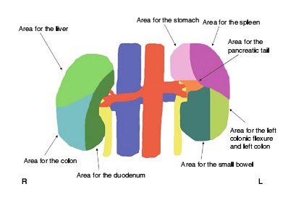
Kidney Anatomy
Retroperitoneal, on posterior abdominal wall
Right lower than left due to liver
Size: 12cm x 7cm x 3cm
Coverings: (inside to outside)
Fibrous capsule
Perirenal fat
Gerota fascia
Pararenal fat
Structure:
Medial = renal hilum (opening into renal sinus space; anterior to posterior = renal vein, renal artery, ureter)
Outer cortex
Inner medulla – divided into pyramids, with renal papilla at apex, which project into calyces to form the renal pelvis
Blood: renal arteries from aorta at L2 (right is longer) which form end-arteries in kidney, renal veins drain into IVC (left longer than right)
Lymph: para-aortic nodes
Nerve: sympathetic T8-L1, parasympathetic from vagus

Slide 5
Anatomy of Ureters
Relations:
R ureter – terminal ileum, caecum, appendix and ascending colon
L ureter – descending colon and sigmoid
Both are crossed by gonadal vessels anteriorly (and vas deferens in males), and related posteriorly to psoas muscle
Narrowings: (site of stones)
Pelviureteric junction
Bifurcation of iliac vessels where ureter enters pelvis
Vesicoureteric junction
Blood: upper third = renal artery and vein; middle third = gonadal artery and vein; lower third = superior vesical artery and vein
Lymph: para-aortic
Nerve: sympathetic (T10-L2), parasympathetic (S2-4)

Slide 6
Bladder Anatomy
Capacity 500mls
Relations:
Superior – apex joined to anterior abdominal wall by median umbilical ligament, superior surface covered by peritoneum
Inferolateral – anterior to pubic bones
Base – triangular that faces posteroinferiorly, seminal vesicles lie below this in males; trigone is the internal surface of base of bladder (ureters enter at its superior angles)
Blood: branches of internal iliac (superior and inferior vesical arteries) and vesical venous plexus to internal iliac vein
Lymph: external/internal iliac nodes
Nerve: Parasympathetic (S2-4), sympathetic (T10-L2), somatic (S2-4)

Slide 7
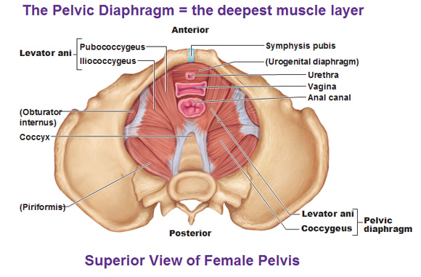
Pelvic Diaphragm
Separates perineum and pelvic cavity
Formed from slings of levator ani (iliococcygeus and pubococcygeus) and coccygeus muscle

Slide 8
Key Features
Pelvic cavity projects posteriorly
Anatomical position = anterior superior iliac spine and pubic symphysis lie in same vertical plane
Important structures cross ureters in pelvic cavity
Men – ductus deferens crosses ureter just posterior to bladder
Female – uterine artery crosses ureter lateral to cervix of uterus
Prostate is anterior to rectum
Perineum is innervated by sacral spinal cord segments
Dermatomes of perineum are from spinal levels S3-S5
Anterior regions from L1
Nerves are related to bone
Parasympathetic innervation from S2 – S4 control erection
Muscles and fascia of pelvic floor and perineum intersect at perineal body
Gender determines course of urethra

Slide 9
Perineum
Inferior to floor of pelvic cavity
Boundaries form pelvic outlet
Contains external genitalia and external openings of genitourinary and gastrointestinal systems

Slide 10
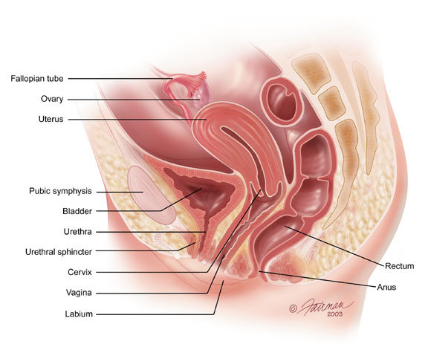
Female Pelvis
Contents
Gastrointestinal system
Rectum
Anal canal
Anal aperture
Urinary system
Bladder
Urethra
Reproductive system
Uterine tubes (fallopian)
Ovaries
Uterus
vagina

Slide 11
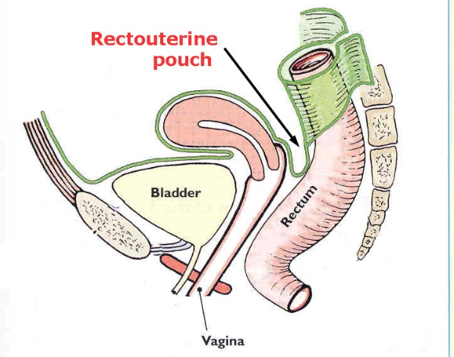
Pelvic Peritoneum
Covers organs
Forms pouches:
Vesicouterine pouch
Rectouterine pouch (of Douglas)
Fluid collects in these pouches
Vesicouterine Pouch

Slide 12
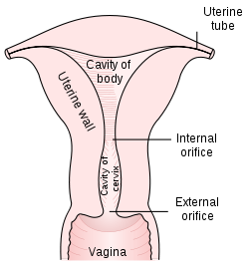
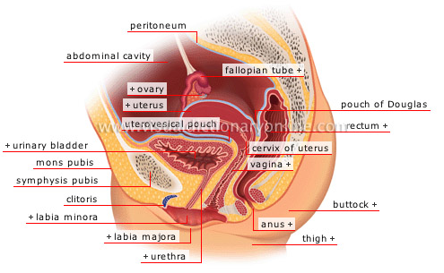
Organs
Ovary
Uterine Tube
Has four sections
Infundibulum (with fimbriae)
Ampulla
Isthmus
Intramural
Uterus
Cervix
Forms cleft with uterus
Cervical Cavity
Internal os
External os
Vagina
Fornices of vagina
Anterior
Posterior
Lateral

Slide 13
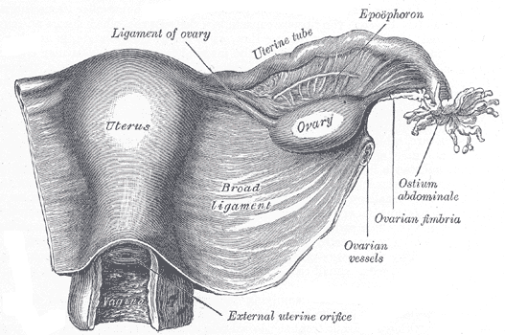
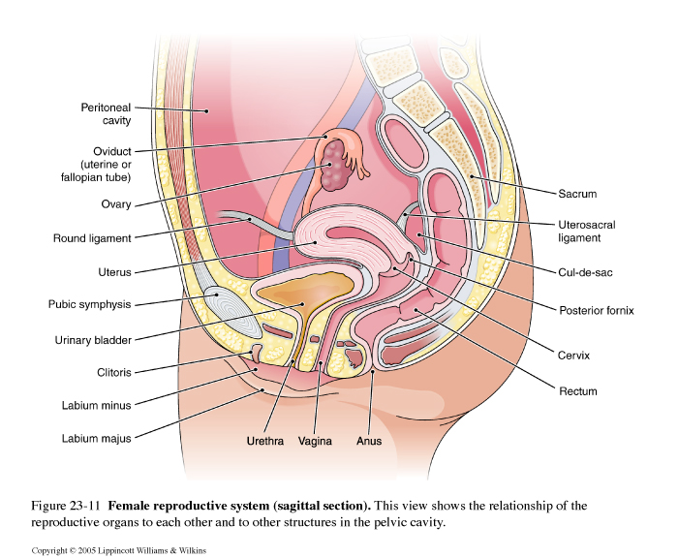

Slide 14
Ligaments
Broad ligament
Suspensory ligament – contains ovarian vessels and lymphatics
Round ligament of the uterus – from uterus to pelvic brim – passes through inguinal canal and is the remnant of the gubernaculum
Transverse cervical ligaments – at base of each broad ligament – extend from cervix and vaginal fornix to pelvic side wall – stabilise cervix
Uterosacral ligaments keep cervix pulled back by attaching to the fascia over the piriformis muscle
Pubovesical ligament extend from the cervix and bladder to pubis

Slide 15
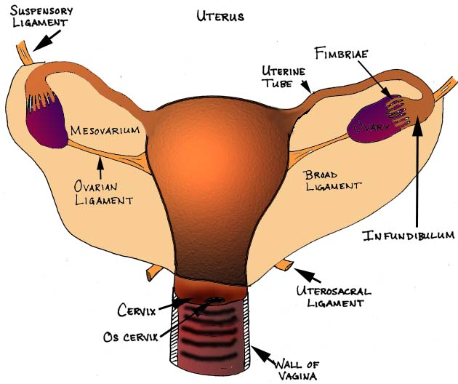

Slide 16
Broad Ligament
Double fold of peritoneum
Anterior layer – pushed forward by round ligament of uterus
Posterior – bulges backwards as mesovarium (suspending ovary)
Connects uterus to pelvic side wall
Forms mesosalpinx for uterine tubes
Forms mesovarium for ovary
Uterine and ovarian vessels and lymphatics, round ligament and suspensory ligament contained within parametrium
Parametrium (cervical stroma) – extends between anterior and posterior layers of the broad ligament

Slide 17
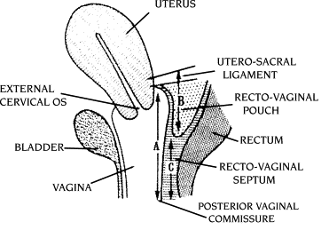
Rectovaginal Fascia
Thin sturcture separating vagina and rectum

Slide 19
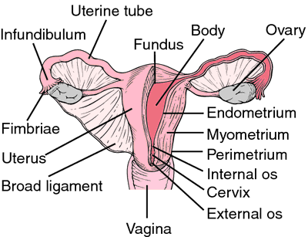

Slide 20
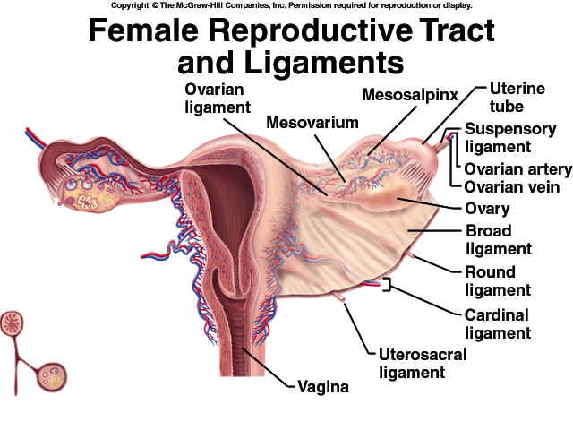

Slide 21
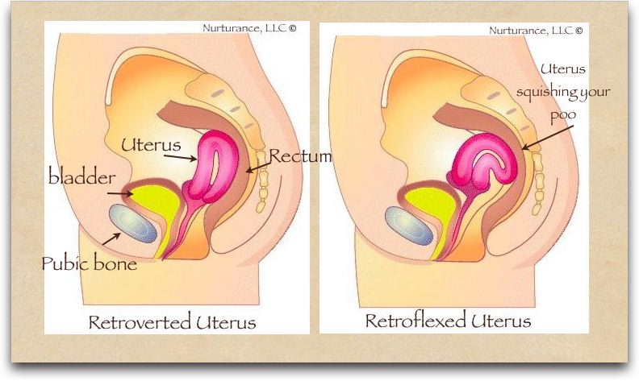
Position of Uterus
Normal position of uterus is antiretroflexed and antiretroverted

Slide 22
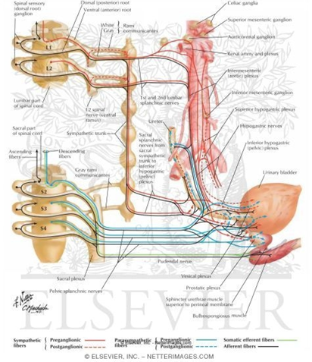

Slide 23
Pelvic Wall Muscles
Made up of obturator internus and piriformis
Obturator internus:
Attached to inferior rami of pubis and ischium
Action is to rotate thigh laterally, helps to abduct thigh
Exits through lesser sciatic foramen
Innervated by nerve to obturator internus (L5,S1, S2)
Supplied by inferior gluteal artery
Covered by obturator fascia
Piriformis:
Exits pelvis through greater sciatic foramen
Superior gluteal vessels originate superior to muscle
Inferior gluteal vessels originate inferior to muscle
Supplied by superior and inferior gluteal arteries and internal pudendal artery
Innervated by nerve to piriformis (L5, S1, S2)
Action is lateral rotator of hip joint, helps to abduct hip

Slide 24
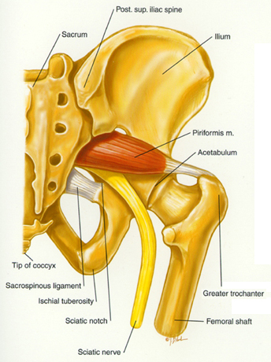
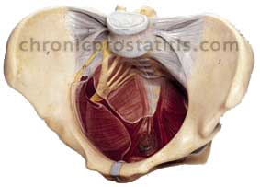

Slide 25
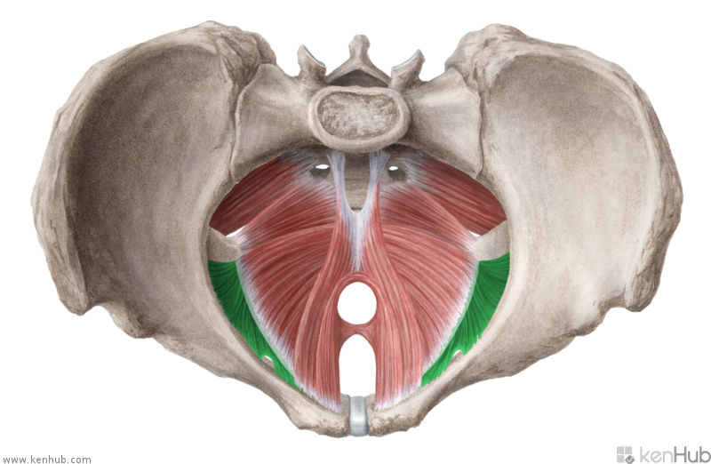
Piriformis
Obturator Internus

Slide 26
Pelvic Floor Muscles
Made up of levator ani group:
Iliococcygeus
Pubococcygeus – controls urine flow
Puborectalis – forms sling around rectum which inhibits defaecation
Levator ani and coccygeus make up pelvic diaphragm
Pubococcygeus forms branches of puborectalis muscle and pubovaginalis/puboprostaticus muscle
Supplied by inferior gluteal artery
Innervated by:
Pubococcygeus/iliococcygeus:
Nerve of levator ani (S4)
Coccygeal plexus
Puborectalis
S3, S4
Nerve of levator ani

Slide 27
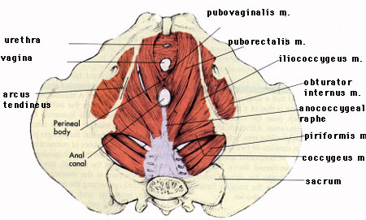

Slide 28
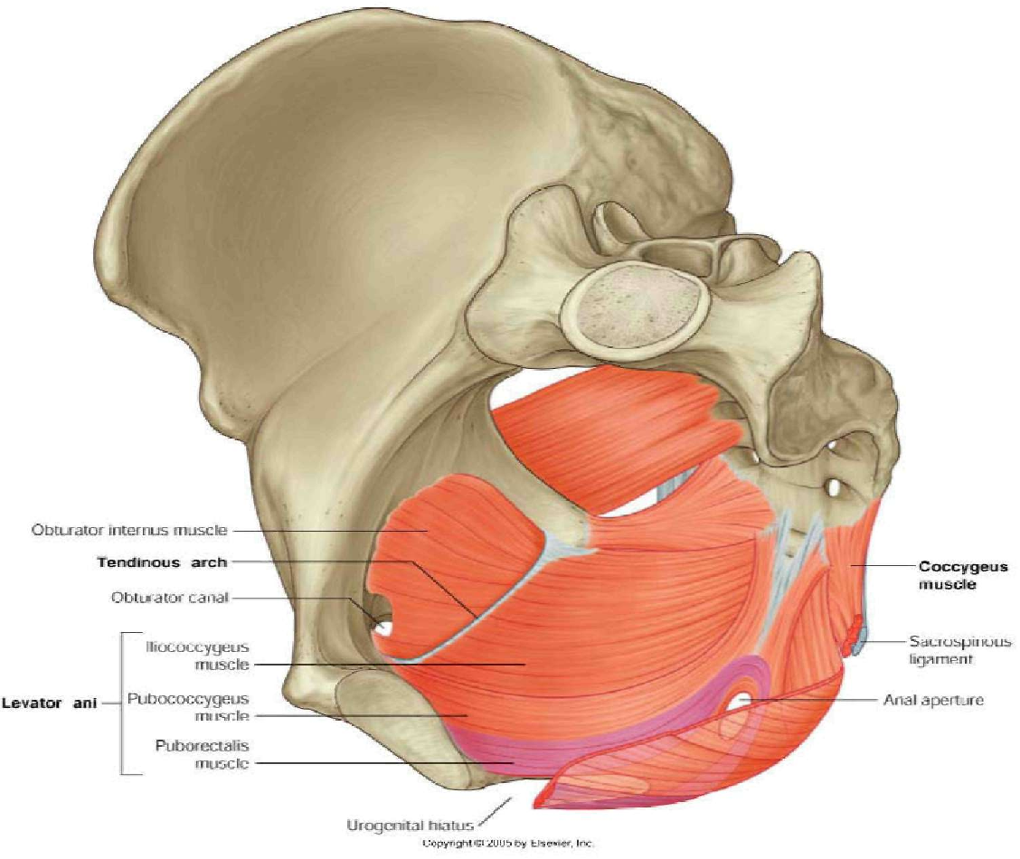

Slide 29
Notes:
TO LABEL!

Slide 30
Notes:
http://www.malepelvicfloor.com/anatomy.html

Slide 31
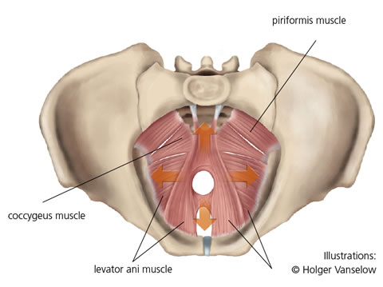

Slide 32
Pudendal nerve
Wraps around sacrospinous ligament to re-enter pelvis and supply perineum
Innervates external genitalia, bladder and rectum
Travels in S2-S4 nerves of sacral plexus
Passes between piriformis and coccygeus muscle
Leaves pelvis through greater sciatic foramen
Crosses spine of ischium to re-enter pelvis through lesser sciatic foramen
Branches:
Inferior rectal nerves
Perineal nerve
Dorsal nerve of penis/clitoris

Slide 33
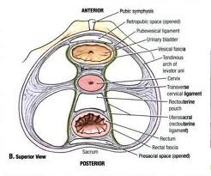
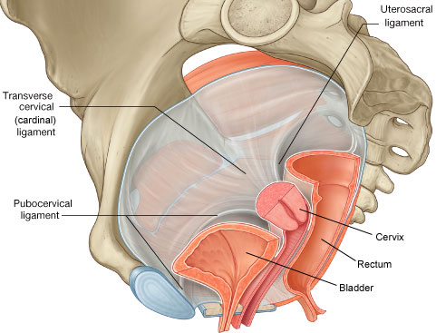
Ligaments
Puboprostatic
Pubovesical
Transverse cervical
Sacrocervical

Slide 34
Perineum

Slide 35
Perineum
Inferior to pelvic floor muscles
Surface region between pubic symphysis and coccyx
Diamond shape
Split into 2 triangles (urogenital and anal)
Has 2 spaces:
Deep perineal space
Superficial perineal space
Deep perineal pouch:
Between pelvic floor muscles and perineal membrane
Contents – see anatomy booklet
Superficial perineal pouch:
Between perineal membrane and skin
Contents – see anatomy booklet
In females, it contains the equivalent of the bulbourethral glands (Bartholin gland)

Slide 36
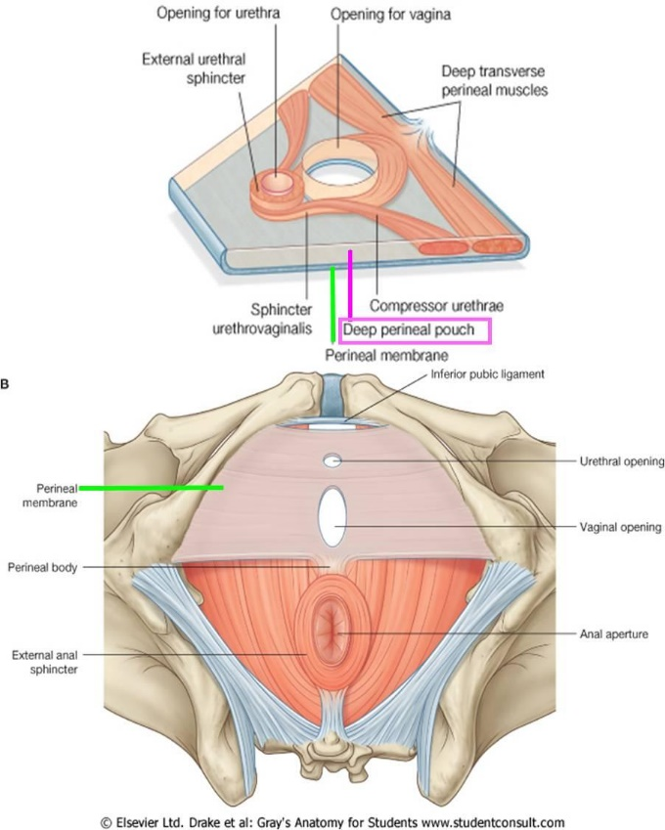
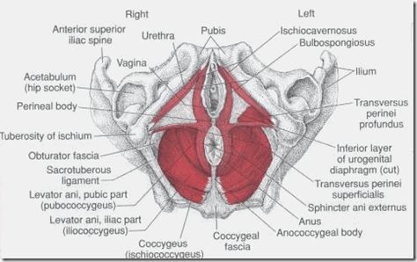
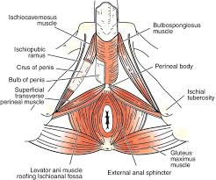
Fascia of Perineum
Perineal membrane
Perineal body
Joining of
all muscles

Slide 37
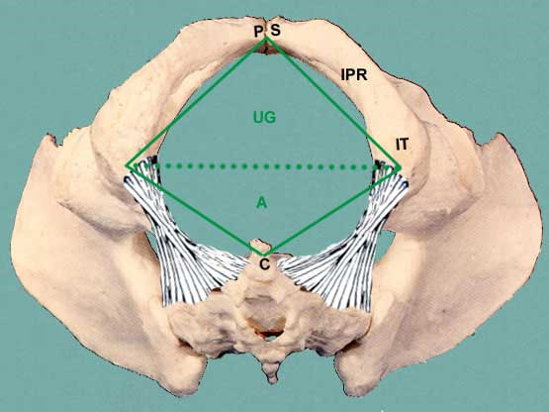
Sacrotuberous ligament

Slide 38
Urogenital Triangle (Male)
Contains root of scrotum and penis
Boundaries:
Pubic symphysis anteriorly
Ischiopubic rami (on each side laterally)
Invisible line between ischial tuberosities dividing two triangles posteriorly
Bulbouretheal gland
- Secrete pre-ejaculate

Slide 39
Urogenital Triangle (Female)
Contains urethra and vagina
Boundaries:
Pubic symphysis anteriorly
Ischiopubic rami (on each side laterally)
Invisible line between ischial tuberosities dividing two triangles posteriorly
Bathrolins gland
Secrete mucus to lubricate vagina
Located in superficial pernieal pouch

Slide 40
Anal Triangle (Both)
Contains anal canal
Boundairies:
Invisible line dividing 2 triangles anteriorly
Sacrotuberous ligaments laterally
Coccyx posteriorly

Slide 41
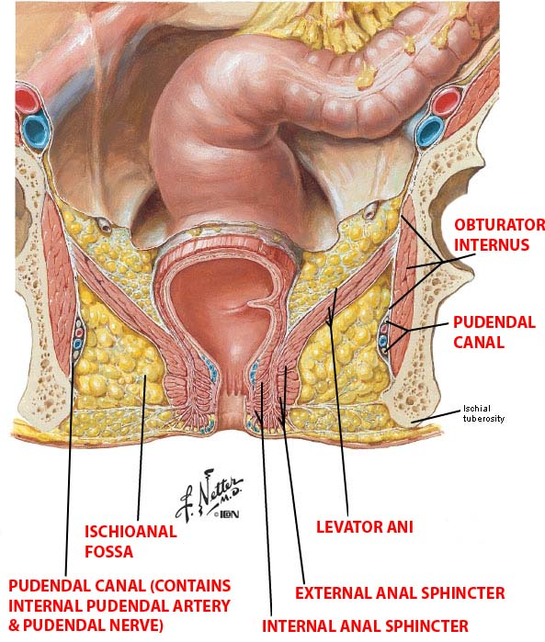
Ischiorectal Fossae
Fat filled spaces inferior to pelvic diaphragm and lateral to anal canal
Contains pudendal canal (pudendal VAN)
Contents:
Inside pudendal canal
Internal pudendal artery
Internal pudendal vein
Pudendal nerve
Outside pudendal canal
Inferior rectal artery and vein
Inferior anal nerves

Slide 42
Perineal Muscles
Urogenital triangle
Ischiovavernosus – covers crura of genitalia
Bulbospongiosus – covers bulbs of erectile tissue
Urethral sphincter
External – controls urination
Innervation – dorsal nerve of penis/clitoris
Blood supply – internal pudendal artery
Internal – controls junction between ureter and bladder
Innervation – inferior hypogastric plexus and lumbar splanchnic nerves
Blood supply – internal pudendal artery
Deep transverse perineal muscle
Innervated by pudendal nerve
Arises from ischial rami
Support pelvic floor
Blood supplied by internal pudendal artery
Superficial transverse perineal muscle
Arises from fibres from ischial tuberosity
Blood supplied by internal pudendal artery
Innervated by perineal nerve (from pudendal nerve)
Anal triangle

Slide 43
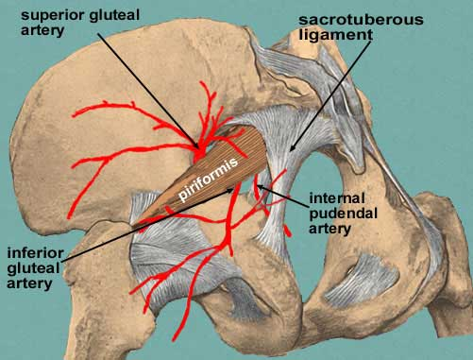
Internal Pudendal artery and inferior gluteal artery go through the greater foramen
Internal pudendal goes back through the lesser foramen

Slide 44
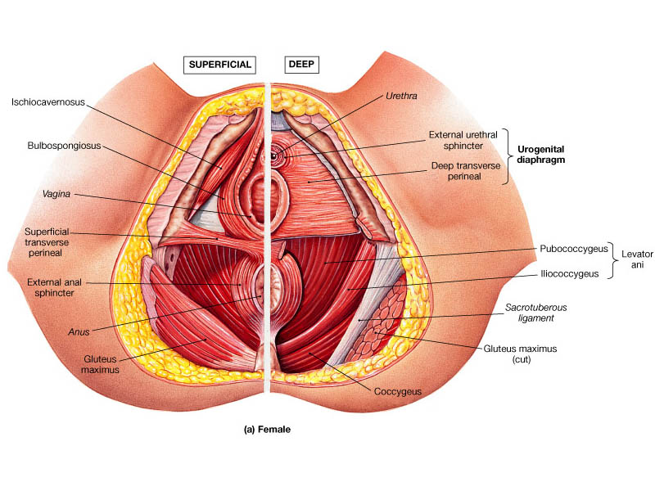
Female

Slide 45
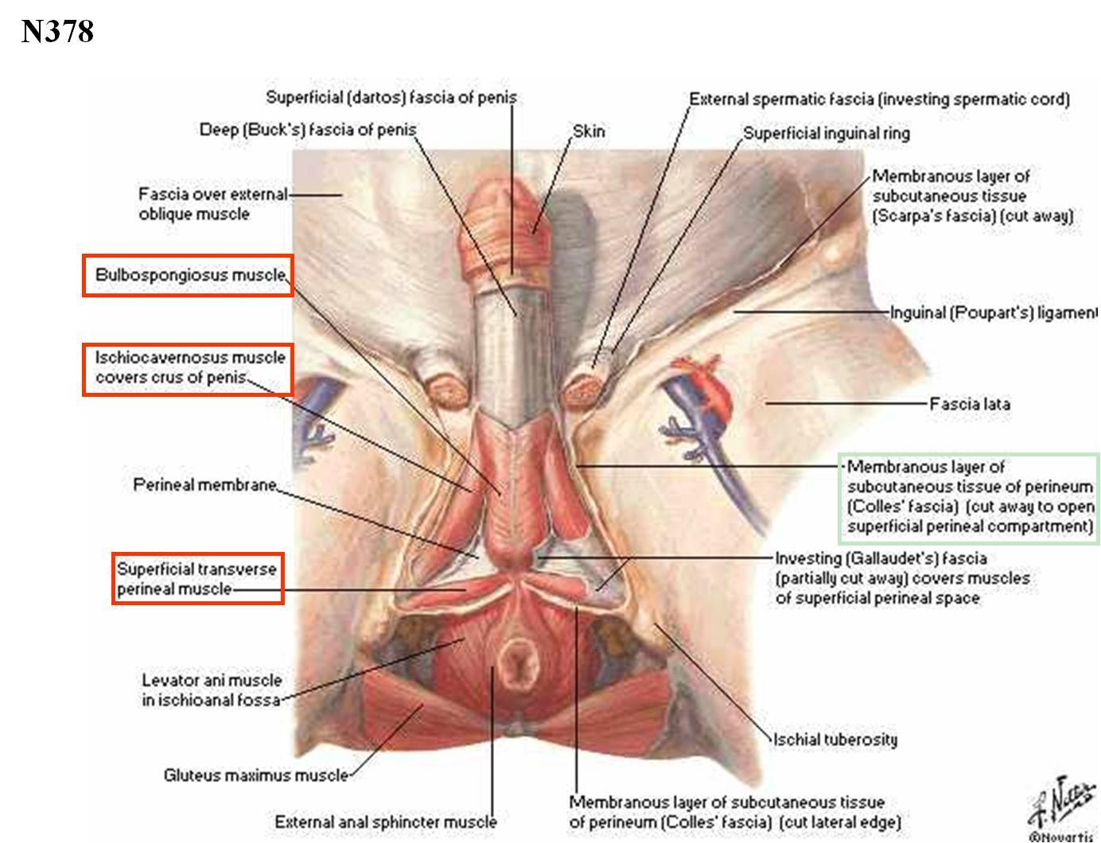
Male

Slide 46
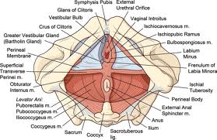

Slide 47
Pelvic Vasculature

Slide 48
Blood Supply
Aorta bifurcates at L4-L5 to form Common iliacs
Common iliacs which bifurcate at intervertebral disc between L5 and S1 to form internal and external iliac arteries
External iliac artery gives off inferior epigastric artery and deep circumflex iliac artery and femoral artery
Internal iliac artery has a posterior and anterior aspect
Posterior: iliolumbar artery – supplies muscles and fascia on sacrum
lateral sacral artery – fascia on sacrum
superior gluteal artery – supplies gluteus medius and gluteus minimus
Anterior: Obturator artery – courses with obturator nerve and vein
Inferior gluteal artery – supplies gluteus maximus
Umbilical Artery – branches into superior vesical artery and medial umbilical ligament (remnant of umbilical arteries)
- Artery to ductus deferens branches from this
Inferior Vesical artery (vaginal artery in women) – bladder (and vagina)
Internal Pudendal Artery – supplies external genitialia
Middle Rectal Artery – supplies rectum
Uterine Artery (female only) – supplies uterus – anastomoses with ovarian artery (a branch of the abdominal aorta)

Slide 49
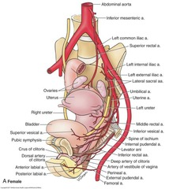

Slide 50
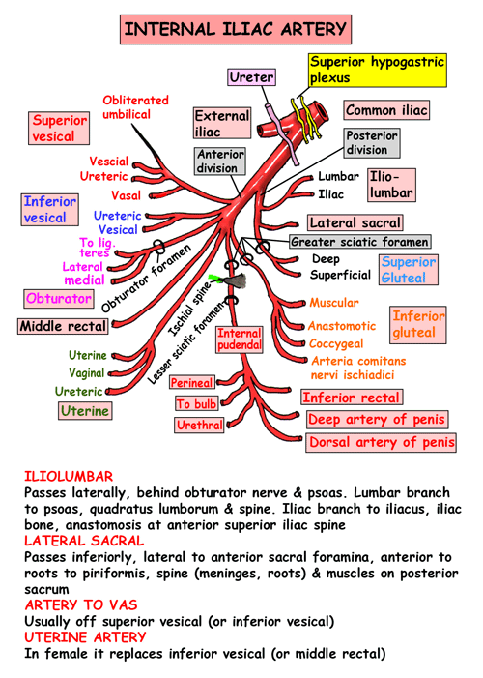

Slide 51
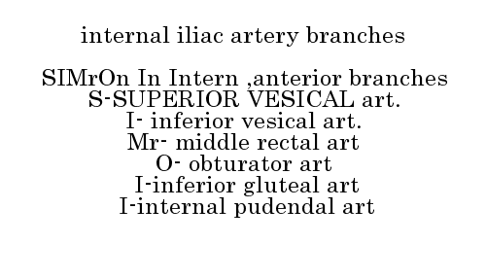

Slide 52
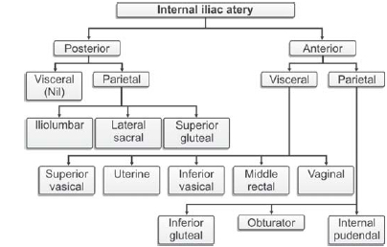

Slide 53
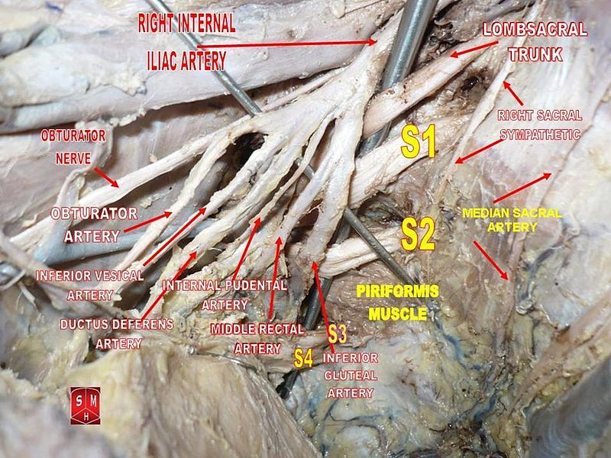

Slide 54
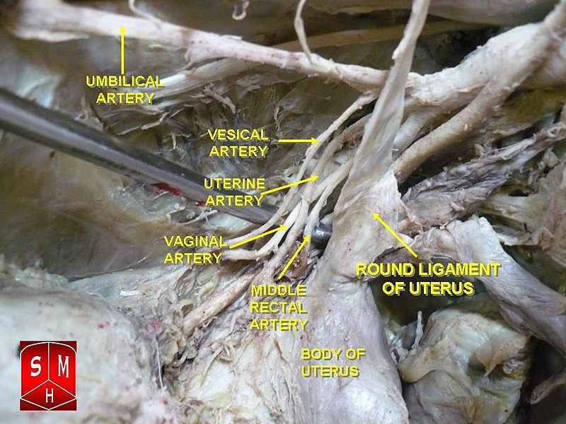

Slide 55
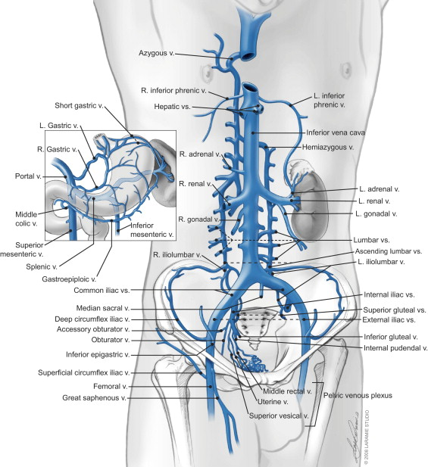
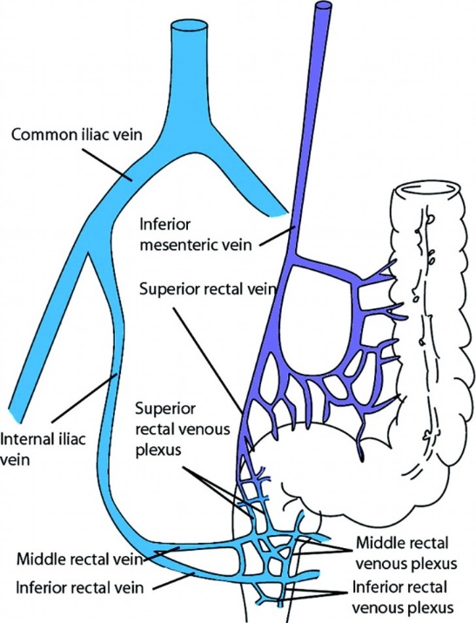
Venous Drainage
Parallel to arterial supply

Slide 56
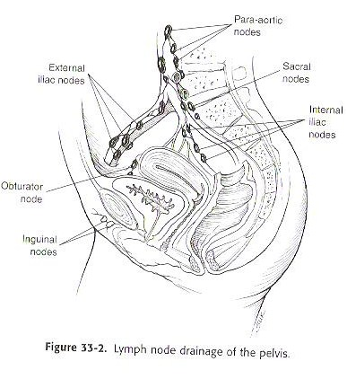
Lymphatics

Slide 57
Male reproductive system

Slide 58
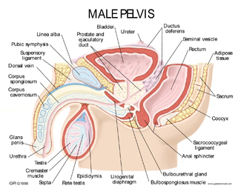
Male Pelvis
Contents:
Gastrointestinal system
Rectum
Anal canal
Anal aperture
Urinary system
Bladder
Urethra
Reproductive system
Seminal vesicle
Vas deferens
Prostate
Ejaculatory duct

Slide 59
Male Genitalia
Male urethra (20cm)
Parts:
1 - prostatic
2 - membranous
3 - bulbar
4 - penile

Slide 60
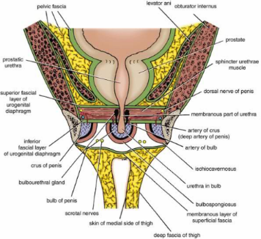
Deep Peritoneal Pouch
Space enclosed by perineum and is superior to perineal membrane
Region between pelvic diaphragm and perineum
Contents:
Muscles
Deep tranverse perineal muscle
External sphincter of urethra
Urethrovaginal sphincter (female)
Membranous/proximal part of urethra (male/female)
Bulbourethral glands (male)
Vagina (females)

Slide 61
Scrotum
Layers:
Skin
Superficial fascia – split into superficial and deep (Colles – continuous with scarpa’s abdominal fascia) layers and contains dartos muscle
Spermatic fasciae – from muscles of anterior abdominal wall
External spermatic fascia – from external oblique
Cremasteric fascia – from internal oblique
Internal spermatic fascia – fascia transversalis
Tunica vaginalis
Tunica albuginea – surrounds each testis
Blood: testicular artery (through inguinal canal), pampiniform plexus formed from testicular veins, left testicular vein drains into left renal vein and right directly into IVC
Lymph: para-aortic nodes

Slide 62
Tunica Albuginea
Fibrous covering of testes
Also makes up the fibrous envelope of the corpora cavernosa penis
Maintains erection

Slide 63
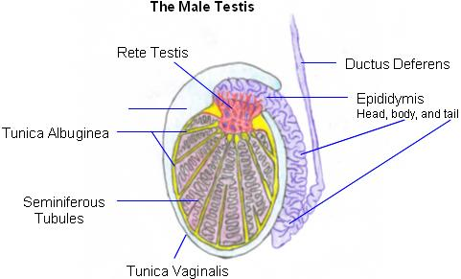
Tunica Vaginalis
Covers tunica albuginea (other than at points of attachment of epididymis and where spermatic vessels enter)
Serous covering of testes

Slide 64
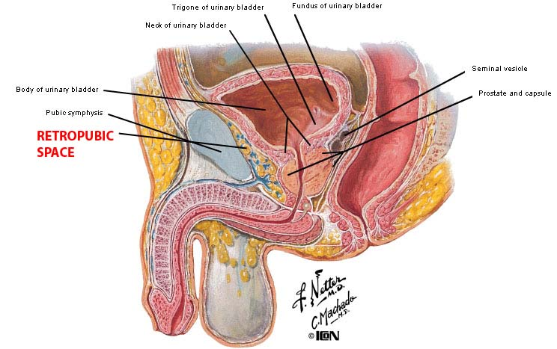
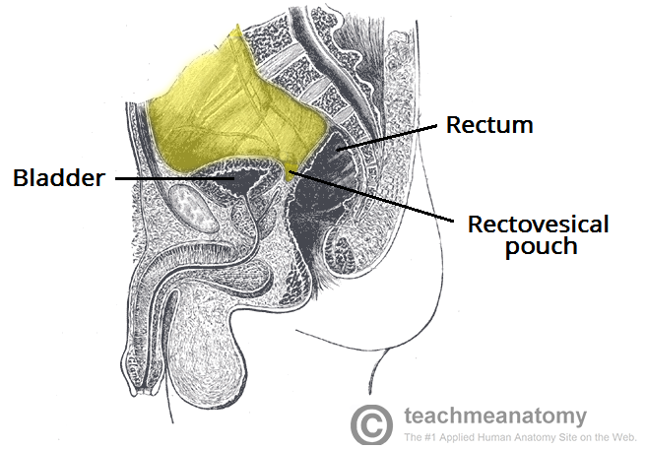
Peritoneum
Visceral peritoneum drapes over bladder onto superior aspect of seminal vesicles
It then reflects onto the anterior/lateral surfaces of rectum
Rectovesical pouch – between bladder and rectum
Different to in females where all of peritoneum forms pouch, in males peritoneum runs over pouch)
Retropubic space is area behind pubic bone
Provides support for proximal urethra and bladder

Slide 65
Organs
Testes
Epididymis
Ductus deferens
Ejaculatory duct
Urethra
Penis
Accessory glands:
Prostate
Seminal vesicles
Bulbourethral glands

Slide 66
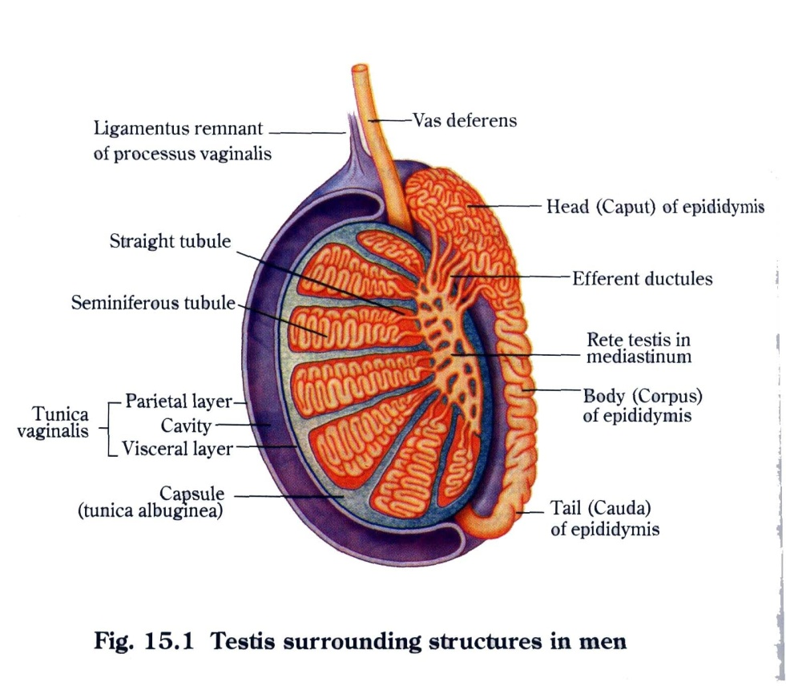
Testes
Originate high on posterior abdominal wall then descend
Lymph drainage: lateral aortic or lumbar nodes
Blood supply: testicular arteries, cremasteric artery, artery to ductus deferens
Venous drainage: pampiniform venous plexus – draining into testicular vein
Innervation from the testicular nervous plexus (sympathetic (T12-L2) and parasympathetic fibres – S2-S4)

Slide 67
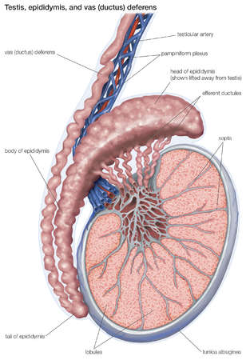
Epididymis
Stores spermatozoa until ejaculation
Blood supply: testicular artery
Venous drainage: pampiniform venous plexus
Lymph drainage: lumbar nodes
Innervation: sympathetic = T12-L2
parasympathetic = S2-4

Slide 68
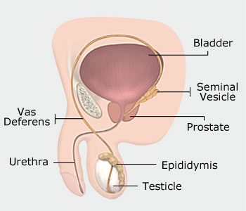
Ductus Deferens
Transports spermatozoa from epididymis to ejaculatory duct
Blood supply: artery of vas deferens
Venous drainage: vein of ductus deferens from superior vesical vein
Lymph drainage: external iliac nodes
Innervation: inferior hypogastric plexus – autonomic nerve fibres (symp = T12-L2, para = S2-S4)
Pudendal nerve

Slide 69
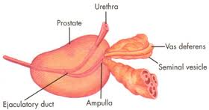
Ejaculatory Duct
Formed by union of ductus deferens and seminal vesicles
Pass through prostate and open into urethra
Blood supply: artery of ductus deferens
Venous drainage: prostatic and vesical plexuses
Lymph drainage: external and internal iliac nodes
Innervation: sympathetic = T12-L2
parasympathetic = S2-S4 (pudendal nerve)

Slide 70
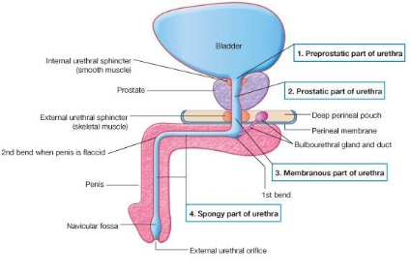
Urethra
Divided into 4 parts:
Pre-prostatic
Prostatic
Membranous
Penile (spongy)
20cm long
Exit for urine and semen
Bend in urethra makes catheterisation difficult
Blood supply: Inferior vesical artery
Venous drainage: Inferior vesical vein
Lymph drainage: internal iliac nodes (deep inguinal nodes for penile urethra)
Innervation: symp = T12-L2, para = S2-S4
Inferior hypogastric plexus
Pudendal nerve
Pelvic splanchnic nerves

Slide 71
Penis
Comprised of:
Root
Right and left crura attached to inferior pubic rami and perianal membrane, surrounded by tunica albuginea
Bulb is attached to centre of perineal membrane and surrounded by bulbospongiosus muscle which continues forward to surround penile urethra and expands to form glans
Body
Three cylinders of erectile tissue enclosed in Bucks fascia
Blood: penile artery (branch of pudendal), venous drainage by dorsal vein
Nerve = pudendal
Lymph = inguinal nodes

Slide 72
Prostate Anatomy
Inferior to bladder and surrounds prostatic urethra
Anatomical relations:
Superior = base of prostate continuous with neck of bladder
Inferior = apex of prostate lies on urogenital diaphragm, puboprostatic ligaments connect prostate to pubic bones
Posterior = separated from rectum by fascia of Denovilliers
Surface: 70% glandular, 30% fibromuscular
Transition zone – BPH occurs here
Central zone – surrounds ejaculatory ducts
Peripheral zone – prostate cancer occurs here
Anterior fibromuscular stroma
Blood supply:
Inferior vesical and middle rectal arteries
Veins from prostatic venous plexus (from deep dorsal vein of penis) into internal iliac vein
Lymph: internal iliac nodes

Slide 73
Prostate
Contributes 30% of seminal fluid
Anchored by puboprostatic ligaments
Comprised of anterior, posterior, lateral and median lobes
Zones: central, transitional, peripheral
Blood supply: inferior vesical artery and middle rectal artery
Venous drainage: prostatic and vertebral venous plexuses
Lymph drainage: internal iliac nodes
Innervation: inferior hypogastric plexus
Can be felt on rectal investigation
Feel for borders and midline

Slide 74
Internal urethral sphincter (smooth muscle)
Urethral sinuses
Urethral crest
Capsule of prostate
Seminal colliculus (verumontanum)
Prostatic utricle
Glandular elements of prostate
Openings of glandular ducts
Fibromuscular stroma
Openings of ejaculatory ducts
Deep perineal pouch
External urethral sphincter
Perineal membrane

Slide 75
Seminal Vesicles
Secretes 60-80% of semen
Open into ejaculatory duct
Blood supply: superior vesical artery
Venous drainage: small veins leading to internal iliac vein
Lymph drainage: external and internal iliac nodes
Innervation: inferior hypogastric plexus and pelvic nerve

Slide 76
Bulbourethral Glands
Accessory glands in deep peritoneal pouch
Secrete pre-ejaculate
Empty into penile urethra
Blood supply: artery of urethral bulb
Venous drainage: vein of urethral bulb

Slide 77
Spermatic Cord
Ductus deferens and tissue from deep inguinal
ring to testes
Contents:
Testicular artery and artery of ductus deferens
Genital branch of genitofemoral nerve
Testicular nerves
Pampiniform plexus of veins
Lymphatic vessels
Tunica vaginalis
Fascia:
External spermatic – from apopneurosis of external oblique muscle
cremasteric muscle and fascia – from internal oblique muscle
Internal spermatic – continous with transversalis fascia

Slide 78
Physiology of Micturition
Storage of urine depends on adequate bladder capacity
Compliance = bladders ability to increase volume with minimal increases in pressure
Relaxation of detrusor muscle as bladder fills
Continence and expulsion of urine requires competent sphincters
Internal smooth muscle sphincter in bladder neck (sympathetic)
External striated muscle sphincter (motor – pudendal nerves)
Timing of micturition is controlled by pons
Pontine micturition centre
Inhibitory input from pons is silenced, allowing urethra to relax
Micturition depends on parasympathetic and detrusor contraction
Parasympathetic stimulates detrusor contraction causes increase in intravesical pressure causing voiding

Slide 79
Incontinence
Involuntary loss of urine
Types:
Extraurethral – due to abnormal anatomy (ectopic ureter, fistula), constant incontinence (overflow due to failure of detrusor muscle and is irreversible)
Self catheterisation
Urethral
stress (sphincter failure due to pregnancy, damage, obesity) – urine loss when high intra-abdo pressure
urge (bladder dysfunction due to organic brain disease, infection) – loss of urine with urgency
Assessment:
Hx and Ex
Ix – MSU, USS (post-void residual), cystoscopy, urodynamic testing
Management:
Stress: lifestyle (exercises), sphincter reinforcement, colposuspension, pubovaginal slings
Urge: bladder retraining, oxybutnin, botox, ilieal conduit

Slide 80
Neurological Bladder Dysfunction
Can lead to over/under activity of bladder/sphincter
High pressure in bladder can cause kidney problems
Ineffective bladder emptying can cause recurrent UTIs
Cerebrovascular disease
Detrusor hyperreflexia – frequency, urgency, nocturia
Spinal cord injury
Initially causes spinal shock - bladder becomes acontractile causing retention, needing catheterisation
Lesions above sacral cord = detrusor sphincter dyssynergia (bladder contracts against closed sphincter causing high pressure and renal damage)
Lesions of sacral cord and cauda equine = paralysis of detrusor causing retention
MS patients have urgency secondary to detrusor hyper-reflexia

Slide 81
Urinary Fistulae
Abnormal connection between 2 epithelial lined surfaces
Cause:
Obs/gynae = birth injury/iatrogenic/malignancy
GI = diverticulitis/malignancy/crohns
Trauma = pelvic fracture
Types:
Vesicovaginal
Vesicocolic
Vesicocutaneous
Ureterovaginal
Symptoms: recurrent UTI, pneumaturia, passive incontinence
Ix: PV exam, cystogram/CT IVU, cystoscopy, dye test, sigmoidoscopy
Tx: catheter and abx, excision of fistula and bladder repair, bowel resection

Slide 82
Urological Infections
Acute infection = e.coli
Chronic infection = multiple organisms, ?foreign body
Definitions:
Bacteriuria = bacteria in urine
Pyuria = WBCs in urine
UTI = bacteriuria + pyuria
Sterile pyuria = pyuria without bacteriuria (?TB/cancer/stones)
Recurrent UTI = > 3 infections per year
Complicated UTI = infection with structural abnormality/immunosuppression
Defence mechanisms by urinary tract:
Acidic urine
High urea
Antibacterial secretions
Repeated voiding (prevent stasis)
Predisposing factors: female, diabetes (glycosuria), obstruction, foreign body)

Slide 83
Lower Urinary Tract Infections
Acute bacterial cystitis
Symptoms: frequency, urgency, dysuria, confusion and sepsis (elderly)
Ix: MSU, culture, if recurrent (USS, XR for stones, cystoscopy if haematuria)
Tx: abx, prophylactic if recurrent
Epididymo-orchitis
Symptoms: testicular pain, scrotal swelling, UTI symptoms
Epididymitis = bacterial (e.coli, due to BOO or STIs), orchitis – viral
Ix: MSU, USS
Tx: scrotal support, analgesia, abx (cipro, doxy if ?STI), assess for BOO
Prostatitis
Linked to BOO
Symptoms: unwell, fever, discharge, tender prostate, ejaculation pain
Ix: cultures
Tx: abx
Fournier’s gangrene
Necrotising fasciitis of male genitalia
Symptoms: crepitus in infected perineum, cellulitis of genitalia, pain
Ix: cultures
Tx: treat quickly with debridement, broad spectrum abx IV

Slide 84
Upper Urinary Tract Infections
Acute Pyelonephritis
Symptoms: pyrexia, loin pain, rigors, preceeded by UTI symptoms
Ix: dipstick, cultures, USS (obstruction), XR KUB (stones)
Tx: abx 14 days
Complications: pyonephrosis (pus in kidneys requiring drainage), perinephric abscess (pus around kidney requiring drainage)
Chronic Pyelonephritis
Symptoms: radiological diagnosis, small atrophic kidney from chronic bacterial infection, CKD
Ix: USS (scarred kidney), IVU (loss of renal parenchyma), VUR – seen on micturating cystourethrogram
Tx: treat cause, abx prophylaxis, nephrectomy
Complications: hypertension, renal impairment, stones

Slide 85
Antibiotic Prophylaxis
Preoperative abx for:
Endoscopic (gent)
Open (gent + met)
Prostate (cipro)

Slide 86
Urinary Stone Disease
80% calcium based; rest = struvite (proteus), uric acid, cystine
Predisposed by: hypercalciuria (increased absorbtion from gut, reduced absorbtion in kidneys), hyperoxaluria (small bowel malabsorption), hyperuricuria (purine ie meat intake), cystinuria, hypocitraturia, infection
RF: carnivores, warm climate, dehydration, previous stones
Formation occurs when urine supersaturated
Symptoms: acute ureteric colic (stone impacted urinary tract (pelviureteric junction, sacroiliac joint, vesico-ureteric junction) causing obstruction, presents as severe pain loin to groin + flanks, writhe in pain); UTI; haematuria; incidental
Ix: IV urogram, XR KUB (seems half of stones), USS (obstruction), CT KUB (replaced IVU)
Tx: <5mm stones pass spontaneously, watch and wait (diclofenac), ESWL (for stones <2cm, can cause colic due to stone fragmentation), ureteroscopy, percutaneous nephrolithotomy (drainage if rigors/signs of sepsis)
Bladder Stones: caused by BOO/urinary stasis, presents as pain/haematuria, removed via fragmentation/open surgery

Slide 87
Urinary Tract Obstruction
Most common cause of upper UTO = stones, malignancy, PUJ obstruction
Most common cause of lower UTO = BPH, stricture
Hydronephrosis – dilatation of renal pelvis, due to obstruction/reflux
Obstruction confirmed on MAG3 scan

Slide 88
Benign Prostate Hypertrophy
Increase in stromal and glandular elements of prostate
Occurs in transition zone – compresses urethra
Symptoms: asymptomatic, LUTS (VOIDING ie hesitancy, straining, dribbling or STORAGE ie frequency, urgency, nocturia), urinary retention (acute/chronic)
Ix: urinalysis (rule out UTI), U+E (rule out obstructive uropathy), PSA (cancer), uroflowmetry (<10ml = obstruction), USS (post-void residual)
Tx: lifestyle (less caffeine), meds (Tamsulosin, finasteride), surgical (TURP – risk of post-TURP syndrome causing electrolyte disturbance (low Na), and urethral stricture

Slide 89
Urinary Retention
Acute – painful inability to micturate
Causes: BOO (BPH, prostate cancer, urethral stricture), neurological disease)
Symptoms: acute inability to pass urine, abdominal pain, palpable bladder
Tx: catheterisation, TWOC (when predisposing factor has been treated), TURP (to treat cause), long term catheter
Chronic
Residual volume >300mls
Symptoms: painless, overflow incontinence, renal failure
Tx: catheterisation, no TWOC!, TURP, self catheterisation

Slide 90
Urological Malignancy
Renal – Bosniak classification of renal cysts (1=benign, 4 = malignant)
Malignant
Renal cell carcinoma
Adenocarcinoma, cannonball mets to lung
Pain + mass + haematuria, paraneoplastic syndrome (EPO secretion)
Ix: USS, CT for staging
Tx: localised = radical nephrectomy/partial, chemo/radio if mets, TK inhibitors if mets
Sarcoma (leiomyosarcoma) – flank pain and weight loss, tx = radical nephrectomy
Metastases
Benign
Angiomyolipoma – conservative, embolization if acute bleed
Oncocytoma – radical nephrectomy as cannot be differentiated with RCC
Bladder
Transitional cell carcinoma (can affect entire urinary tract)
80% are superficial (Ta T1 CIS)
Patterns = papillary/solid invasive/CIS
RF: smoking
Symptoms: painless haematuria
Ix: flexi cystoscopy
Tx: TURBT (transurethral endoscopic resection), chemo (mitomycin C), immunotherapy, cystectomy if invasive with radiotherapy, nephroureterectomy (if ureter involved)
Cystocopies regularly after treatment to check reccurence
Others:
Squamous – resect
Adenocarcinoma – surgery and chemo
Prostate
Most common malignancy
RF: lifestyle, genetic, African
Adenocarcinoma, in peripheral zone
Grading = Gleason score (2 biopsies taken)
Symptoms: asymptomaic, BOO, mets
Ix: PSA (not specific), biopsy (via TRUS)
Tx: watch and wait, prostatectomy, radio, hormonal (LHRH agonists, antiandrogens
Testicular
Types: Germ cell (seminomas, NSGCTs), stromal (Leydig)
Seminomas – anaplastic/spermatocytic
NSGCTs – embryonal/yolk sac/choriocarcinoma/teratoma
Symptoms: painless lump
Ix: AFP, b-HCG, LDH, USS
Tx: radical orchidectomy (chemo and radio for seimnomas)
Penile
Squamous
RF: HPV
Symptoms: lesion on glans
Tx: surgical excision and chemo

