Slide 1
Cardiothoracic Surgery

Slide 2
Surgery for ischaemic heart disease

Slide 3
Ischaemic Heart Disease
Due to atherosclerosis
Endothelial dysfunction due to risk factors (HTN, high lipids)
Lipid (LDL) accumulation (in subendothelial macrophages)
Monocytes that engulf cholesterol are called foam cells
Smooth muscle migration and fibroblast proliferation (intimal thickening) due to release of TNF and IL-1
Chronic inflammatory response (calcification of plaque)
This slowly causes flow limitation on exercise, causing angina or can rupture causing ACS
LAD, circumflex and right coronary most affected
Internal thoracic mammary arteries spared so are used to revascularise heart

Slide 4
Indications for Coronary Artery Revascularisation
If medical therapies insufficient
PCI used first line for MI then CABG
Can perform simultaneous valve replacement with CABG
PCI has high rate of recurrence but is minimally invasive

Slide 5
Preoperative Considerations
History – NYHA1 score (impact on physical activity)
Examination – listen to carotids ?CVA risk
Investigations
CABG requires coronary angiography
ECG, CXR (and lateral if re-do), pulmonary function tests, bloods
Adjust medications
Warfarin – suspend for 72 hours and systemic heparinisation
Platelet antagonists
Aspirin – COX inhibitor, stop 7 days pre-op
Clopidogrel – platelet ADP-receptor antagonist, stop 5 days pre-op
Abciximab – IIB and IIIa inhibitors
ACEi – stop 7 days pore-op (risk of vasodilation)
Discuss/Consent
1% CVA/MI/prolonged ventilation/infection
EuroSCORE to assess perioperative mortality

Slide 6
Intraoperative Considerations
Anaesthesia
Patient monitoring
ECG/ventilation/arterial line/pulmonary artery catheter (measure left ventricular preload and CO) /temperature/TOE (evaluates cardiac function)
Antibiotic prophylaxis – cefuroxime IV 3 doses
Patient positioning – supine for median sternotomy

Slide 7
Median Sternotomy Incision
https://www.bing.com/videos/search?q=median+sternotomy&&view=detail&mid=4CB6C0C16F5B8DC33E1F4CB6C0C16F5B8DC33E1F&FORM=VRDGAR
2cm below sternal notch to xiphoid
Bone saw through sternum, move thymus, identify brachiocephalic vein
Complications:
Immediate: vessel injury, chamber injury
Late: sternal dehiscence, sternal osteomyelitis, wire sinuses
Sternal closure
Ensure good haemostasis, use steel wires to close sternum (avoid injuring IMA when placed in intercostal spaces)

Slide 8
Cardiopulmonary Bypass
Divert blood away from heart and lungs, while maintaining oxygen delivery to rest of body
Aims:
Pumping to replace heart
Oxygenation and CO2 extraction
Total systemic cooling to reduce O2 consumption
Bloodless field to operate
Still heart to operate on
Anticoagulate with heparin to prevent clots in system
Components
Venous cannula, venous reservoir, heat exchanger, pump, membrane oxygenator, aortic pipe, cardiotomy suction , cardioplegia delivery (cold blood with K+ to arrest heart and maintain myocardial energy stores by stopping contraction)
Physiological conditions
Non pulsatile flow (mean perfusion pressure 60mmHg)
Systemic cooling (30-32’) – total circulatory arrest for aortic surgery
De-airing to prevent CVA – performed at aortic root
Complications
Coagulopathy/inflammatory activation due to foreign material/CVA from air embolus/bleeding/cardiogenic shock/impaired cognitive performance
Because of these, CABG replacing it (Off pump surgery)
Intra-aortic balloon pump
Indicated if poor CO preoperatively/poor haemodynamics anticipated post-op
Inserted into femoral artery and placed in descending aorta, inflates in diastole and deflates in systole
https://www.bing.com/videos/search?q=cardiopulmonary+bypass&&view=detail&mid=0FD50DE2016EBE2CB1010FD50DE2016EBE2CB101&FORM=VRDGAR

Slide 9
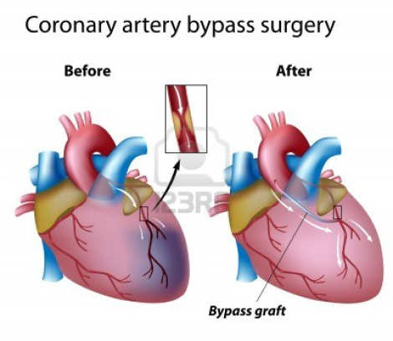
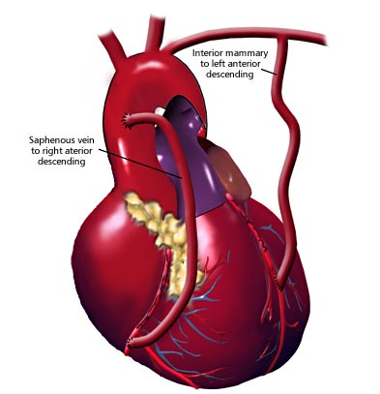
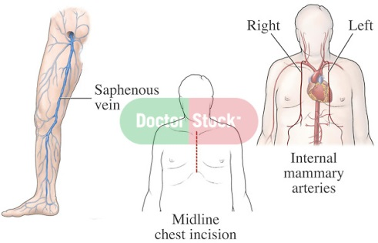
Cardiac Surgery for Ischaemic Heart Disease
CABG - https://www.bing.com/videos/search?q=cabg&&view=detail&mid=4F72B44C57ECADF5BED94F72B44C57ECADF5BED9&FORM=VRDGAR
blood diverted from aorta back to coronary artery distal to stenosis (either harvested artery anastomosed from ascending aorta to coronary vessel OR using IMA and diverting flow by ligating musculophrenic artery and anastomosing to coronary artery)
Coronary targets identified by angiography
Triple bypass grafts:
left internal mammary artery (LIMA) to LAD
Portion of harvested long saphenous vein from aorta to circumflex
Portion of harvested long saphenous vein from aorta to distal right coronary artery
Saphenous grafts being replaced with radial artery grafts
Harvests
Saphenous – mark when harvesting to orient correctly for blood to flow through valves
LIMA
Radial artery – use vasodilating drugs to stop spasm,
use Allen test to ensure good ulnar flow

Slide 10
Complications of CABG
Immediate
Bleeding – surgical (dehiscence) or non-surgical (coagulopathy) – risk of tamponade
Low cardiac output syndrome – due to poor ventricular function, incomplete revascularisation and inadequate myocardial protection; Tx: maintain sinus rhythm (meds or pacing), vasodilators to reduce afterload, intra-aortic balloon pump to assist systolic emptying)
MI – due to poor flow through conduit; Tx: O2, nitrates, intra-aortic balloon pump
Neurological complications – nerve damage due to harvesting, CVA
Early
Pneumonia
Sternal infections – sternal click on movement, sternal instability on examination, needs sternal debridement and rewiring and long term abx
Linked to diabetes, PVD, obesity, re-opening
Leg infections
Renal failure – acute on chronic
Atrial dysrhythmias – due to electrolyte imbalance/sepsis, Tx = rate/rhythm control (SEE FINALS FLOW CHART)
Upper GI bleed and perforation – requires endoscopy/surgery
Late
Recurrent stenosis

Slide 11
Percutaneous Coronary Interventions
Principles
Cannula placed in femoral/radial artery
Guidewire followed by fine cannula passed from artery around aortic arch to coronary ostia under fluroscopy
Dye injected into coronary ostia to visulaise systems
Depending on findings, can do PCI or CABG to treat lesions
PCI has two types
Angioplasty – inflation of balloon at site of stenosis to flatten plaque and increase lumen, can result in re-stenosis
Stenting – expandable metal stent mounted on a balloon deployed in area of stenosis, balloon inflated so stent irreversibly expands in lumen, less risk of restenosis but blood can clot within stent

Slide 12
Cardiac Transplantation
Indicated when can’t be treated medically/surgically (usually cardiomyopathy/congenital defect)
Can be transplanted with lungs
Brainstem dead donors matched against recipient for height and weight and blood group
Echo performed on donor to check heart function
https://www.bing.com/videos/search?q=cardiac+transplant+procedure&&view=detail&mid=330A161911E0FF21E1C4330A161911E0FF21E1C4&FORM=VRDGAR

Slide 13
Surgery of heart valves

Slide 14
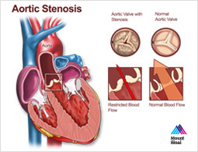
Aortic Stenosis
Pathology
Mild (>1.5cm), moderate (1-1.5), severe (< 1cm)
Transaortic pressure gradient is normally 0 but increases with stenosis (if >50, need surgery) and a resistance to forward flow causing increased LV work and therefore left ventricular hypertrophy . This increases O2 demands of heart
Caused by calcification or hx of rheumatic fever
Calcification may also cause element of regurgitation
Rheumatic may cause other valve problems
Symptoms: SAD
Tx = valve replacement (prosthetic or mechanical) as repair is unsuccessful https://www.bing.com/videos/search?q=aortic+valve+replacement&&view=detail&mid=88DF8852415420FF671388DF8852415420FF6713&&FORM=VDRVRV
Young people should get mechanical
If prosthetic, don’t need warfarin
Pre-op prep as for coronary artery surgery
Minimise risk of endocarditis (dental exam, chest exam, urine dip, temp)
Post-op give warfarin within 48 hours if required
Transcatheter alternatives to replacement have been developed with are minimally invasive (TAVI) - https://www.bing.com/videos/search?q=aortic+valve+replacement+tavi&&view=detail&mid=727CE9E101853D4AB438727CE9E101853D4AB438&&FORM=VDRVRV
Seldinger technique through common femoral or subclavian artery
Complications – see CABG + endocarditis

Slide 15
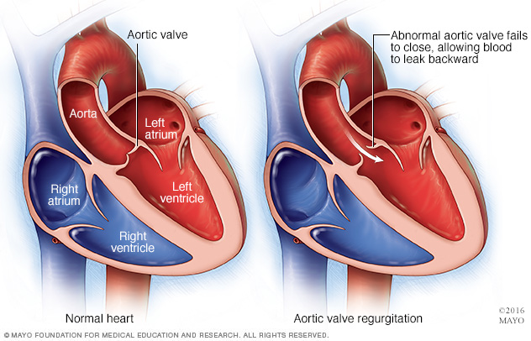
Aortic Regurgitation
Pathology
Caused by rheumatic fever/Marfan’s/ endocarditis/type A aortic dissection
S: pulmonary venous hypertension (asymptomatic, SOB, orthopnoea, PND, pulmonary oedema, angina, wide pulse pressure)
CXR (enlarged LV)
Surgery indicated for symptomatic patients/LV dilatation/acute aortic dissection
Valve replacement
Pre-op need echo
Complications – see AS

Slide 16
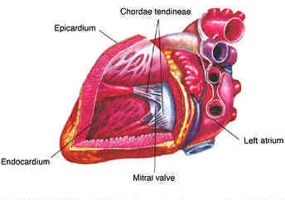
Mitral Regurgitation
Pathology
Posterior leaflet prolapses
Caused by:
Disorders of leaflet: senile degeneration
Disorders of papillary muscle: chordal rupture allows leaflet prolapse, papillary muscle rupture post-MI
Disorders of left ventricle: ventricular dilatation (due to ischaemia or cardiomyopathy)
Tx = repair https://www.bing.com/videos/search?q=mitral+valve+repair+&&view=detail&mid=D808D76C324DB1B63D4CD808D76C324DB1B63D4C&&FORM=VDRVRV OR replacement https://www.bing.com/videos/search?q=mitral+valve+replacement+&&view=detail&mid=C5DB242582A47BF297C8C5DB242582A47BF297C8&&FORM=VDRVRV (prosthetic/mechanical) to prevent left atrial dilatation, pulmonary hypertension and artrial fibrillation (done via median sternotomy)
Chronic MR → left atrial dilatation → raised pressure in pulmonary circulation → pulmonary oedema
Left atrial dilatation also causes atrial fibrillation
Pre-op as for all cardiac surgery (echo with TOE)
Repair avoids need for warfarin
Complications
See CPB
Fail to wean from CPB because of increased LV work
Endocarditis

Slide 17
Mitral Stenosis
Pathology:
Caused by rheumatic fever
Leaflet thickening
Asymptomatic
Can cuase left atrial hypertrophy, pulmonary oedema and eventually right ventricular hypertrophy and tricuspid regurgitation (due to pulmonary hypertension)
Tx = open by percutaneous valvotomy OR replacement

Slide 18
Other surgical pathology

Slide 19
Myocardial and Pericardial Disease
Cardiomyopathy (causes myocardial dysfunction)
Dilated – loss of ventricular function and increased ventricular volume, Tx = medical
Restrictive – amyloid deposition in myocardium causing loss of diastolic function due to decreased ventricular compliance
Hypertrophic obstructive – ventricular hypertrophy, causes sudden death in young people, autosomal dominant, angina/dyspnoea/syncope/dizziness on exertion, Tx = B blocker and calcium antagonists, septal myomectomy to relieve subaortic obstruction
Restrictive pericarditis – inflammation causing pericardial thickening leading to ventricular compression and limited diastolic filling (reduced CO)
Fluid retention, exertional dyspnoea
Tx = pericardectomy
Pericardial effusion – inflammation of pericardium stimulating accumulation of fluid (tamponade rare as slow development of collection)
Pain, SOB
Tx = create subxiphoid pericardial window to drain fluid into abdo cavity

Slide 20
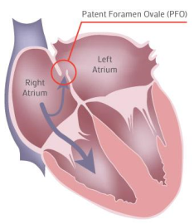
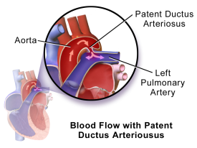
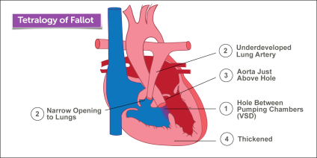
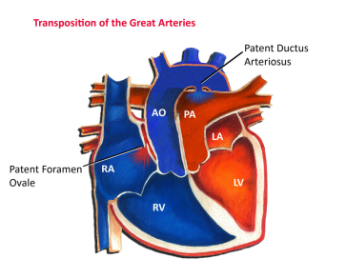
Congenital Heart Disease
Patent foramen ovale
Failure of closure of hole between atria
In utero, foramen ovale allows blood to bypass pulmonary circulation
Atrial septal defect
Atrial septum forms from primum and secundum portions
Ostium secundum is most common type of ASD
S: pulmonary hypertension and exertional dyspnoea (due to left to right shunting), AF, parasternal heave, splitting of second heart sound, mid-diastolic murmur
Tx: percutaneous closure via catheter/pericardial patch repair
Ventricular septal defect – hole in intraventricular septum (congential or after MI /endocarditis)
degree of left to right shunting depends on size of hole
Small defects asymptomatic until adulthood
S (if large defect): tachypnoea, hepatomegaly, poor growth, cardiomegaly
S (if small defect): systolic murmur, small shunts may be asymptomatic
Eisenmenger syndrome = pulmonary hypertension with reversal of left to right shunt
Patent ductus arteriosus – persistence of lumen in ductus arteriosus which connects pulmonary artery to arch of aorta (allowing blood to bypass pulmonary circulation)
S: tachycardia, tachypnoea, irritability, slow weight gain, pulmonary oedema, machinery murmur, hepatic enlargement, cardiomegaly
Tx: NSAIDs can induce closure, interventional radiology, surgical ligation
Tetralogy of Fallot – VSD + pulmonary stenosis + over-riding aorta + RV hypertrophy
Infants are cyanosed due to mixing of oxygenated/deoxygenated blood
Tx: shunting procedure (to bypass pulmonary stensosis and increase pulmonary blood flow and oxygenation) OR definitive surgery to close shunt and patch repair of VSD
Transposition of great vessels
Aortic root arises from right ventricle and pulmonary truck from left – parallel circulations
Tx: shunting procedure OR arterial switch to definitively re-anastomose to correct vessels

Slide 21
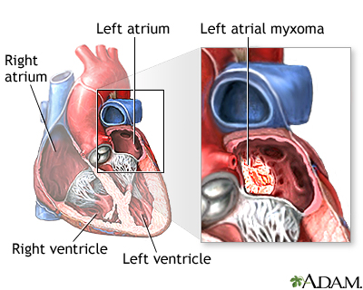
Cardiac Tumours
70% benign
Atrial myxoma most common
Arise from intra-atrial septum in left atrium
Symptoms due to obstruction of blood flow and embolisation of tumour fragments
Tx: excision using CPB
Rarer tumours
Benign
Lipoma
Cystic tumour of AV node
Malignant
Rhabdomyosarcomas
Angiosarcomas
Myxosarcomas
Fibrosarcomas
Leiomyosarcomas
Liposarcomas

Slide 22
Thoracic surgery for carcinoma

Slide 23
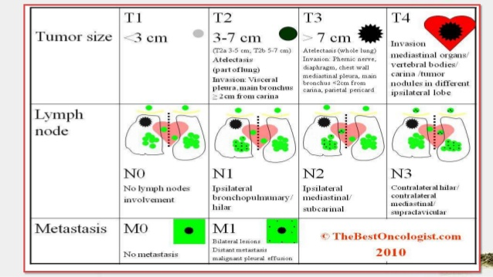
Pathology of Bronchogenic Carcinoma
S: asymptomatic/cough, weight loss, chest pain, SOB, haorseness, clubbing, lymphadenopathy, ptosis (Horners)
CXR (pleural effusion, lobar collapse, discrete opacity)
Small cell carcinoma
Rarely operated on
High mitotic rate so rapid metastases (presents late)
Tx: palliative chemotherapy
Non-small cell carcinoma
Operate if fulfil certain criteria
Histology
Adenocarcinoma (30%)
Squamous cell carcinoma (35%, cavitating lesion on CXR)
Carcinoid tumour (neuroendocrine, often recurs)
Slower growing and less aggressive
Management
Surgery for complete resection if:
Patient has good cardiovascular status/sufficient lung function to be able to lose some (predicted FEV1)/good performance status
Tumour not disseminated, has good morbidity, no metastases, no evidence of N2/N3
Obtain lymph node sampling

Slide 24
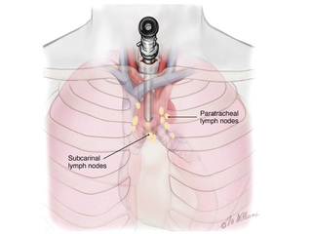
Preoperative Staging
Accurate tumour staging
Clinical examination for lymphadenopathy/mets
CT C/A/P
Fine needle aspiration
Bronchoscopy (view airways under direct vision)
Flexible – low risk of trauma
Rigid – allows bigger biopsies
Mediastinoscopy – examination and biopsy of paratracheal, tracheobronchial and subcarinal nodes
Risk of damage to brachiocephalic artery and oesophageal perforation
Indications varied

Slide 25
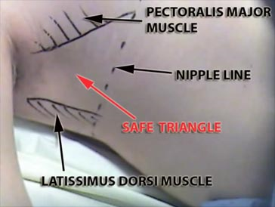
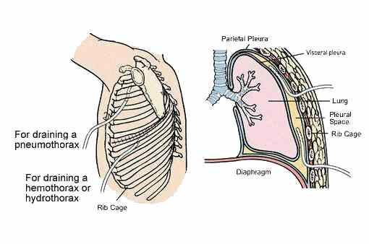
Thoracic Incisions
Anterolateral thoracotomy – used in emergencies https://www.bing.com/videos/search?q=anterolateral+thoracotomy&&view=detail&mid=D4A4EC018FD37D963A40D4A4EC018FD37D963A40&&FORM=VDRVRV
Posterolateral thoracotomy – used in elective surgeries https://www.bing.com/videos/search?q=posterolateral+thoracotomy&&view=detail&mid=AD608BD8919AA9B55DB3AD608BD8919AA9B55DB3&&FORM=VDRVRV
Chest drain insertion https://www.bing.com/videos/search?q=ches+drain+insertion&&view=detail&mid=8D6F8E3170A1E32A6C028D6F8E3170A1E32A6C02&&FORM=VDRVRV
used for management of pneumothorax, haemothorax and pleural effusions
28/32 Fr drain used
Anterior to midaxillary line
Place apical for air (pneumothorax) and basal for blood (effusion/haemothorax)
Video-assisted thoracic surgery
Similar to laparoscopy but gas inflation not required

Slide 26
Thoracic Procedures
Lung resection
Pneumonectomy (whole lung) – for central tumours, done via posterolateral thoracotomy
Complications; bleeding, chest infection, death
Resulting gap fills with fluid (opaque on CXR)
Lobectomy (lobe) – most commonly performed, used via video assisted surgery, via posterolateral thoracotomy, insert 2 temporary drains on closure for air and fluid
Complications; bleeding, chest infection, air leaks due to parenchymal injury
Wedge resection (small bit of tissue) – for benign pathology, lung biopsy performed
Pleurodesis – used to fuse pleural space
Eliminate potential space in those with recurrent pneumothoraces and mesothelioma
Techniques
Kaolin insufflation – talc pumped into thoracic cavity causign adherence
Pleural abrasion – abrased using paper to create raw inflamed surface
Pleural stripping – parietal pleura stripped off
Complications
Pain – causes reduced chest expansion so may cause pneumonia
Postoperative pyrexia – deemed a sign of successful pleurodesis
All require single lung ventilation via dual-lumen endotracheal tube

Slide 27
Other thoracic surgical pathology

Slide 28
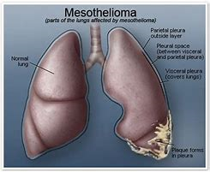
Mesothelioma
Linked to asbestos exposure
Asbestos plaques (pleural thickening) transform into mesothelioma
Subtypes
Epithelial
Sarcomatoid
Mixed
S: SOB, pleural effusion, chest discomfort, chest pain
Diagnosed histologically (1cm square of pleura needed)
Tx: palliative pleurodesis, pleuropneumonectomy in very few

Slide 29
Empyema
Presence of infected material within chest cavity
Occurs as complication of thoracic surgery or after pneumonia
Accumulation of parapneumonic pleural effusion → invasion of microorganisms and fibrin deposition → fibrosis forms fixed empyema cavity
S: persistent fever, SOB, pleuritic chest pain, ↑WCC, lateral CXR shows D shaped shadow, Chest CT
Tx: antibiotics, removal of pus and obliteration of cavity (via decortication (in young) or rib resection (in old))
Complications: air leak and bleeding
Can erode though chest wall – empyema necessitans

Slide 30
Pneumothorax
See finals notes
Surgical management
Bullectomy and pleurodesis performed using video assisted surgery

Slide 31
COPD
See finals notes
Can have symptomatic benefit from lung volume reduction surgery
Has high morbidity and mortaliy

Slide 32
Lung Transplantation
Can be transplanted singly, bilaterally or in combination with heart
Indications:
COPD (a1-antitrypsin deficiency)
Cystic fibrosis (bilateral transplant)
Fibrosing lung disease
Congenital heart disease (ie Eisenmenger syndrome) – heart and lung transplant
Finding donors is difficult due to brainstem death causing aspiration and pneumonia
Crietria: <55, ABO-compatible, clear CXR, minimal smoking history, no chest trauma, no aspiration
https://www.bing.com/videos/search?q=lung+transplantation&&view=detail&mid=76880D13DAB8F988358576880D13DAB8F9883585&&FORM=VDRVRV
Complications
Bleeding, bronchial stenosis, early graft dysfunction , rejection, infections, death

Slide 33
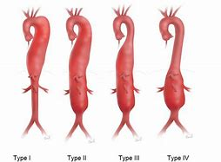
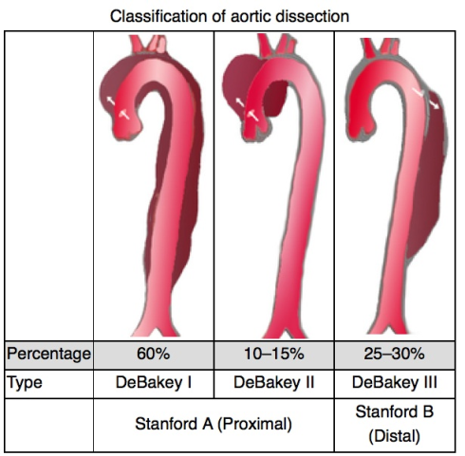
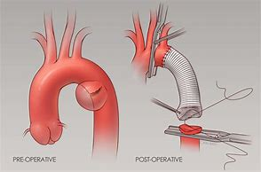
Thoracic Aortic Pathology
Thoracic Aortic Aneurysm
Link to Marfan Syndrome, atherosclerosis, trauma, Kawasaki syndrome
Classification:
Ascending
Arch
Descending thoracic
Thoracoabdominal (Crawford classfication – Extent)
Asymptomatic/chest pain, aortic regurgitation, back pain, SOB, haematemesis, death
Diagnosed on MRI/CT/transoesophageal echocardiograhy
Surgery indicated if >5.5cm, complications or symptomatic
Involves prosthetic graft
Complications
Pulmonary/bleeding/neurological/false aneurysms/graft infection
Aortic Dissection
Blood escapes aortic lumen via intimal tear and creates false lumen
Causes: HTN, aortitis (from syphilis) , CTD (Marfans),
S: shock (hypovolaemia, tamponade, acute aortic regurgitation, MI), pain, end organ ischaemia (pulseless cold legs, oliguria, paraplegia)
Ix: CXR, TOE, CT with contrast, aortography (GOLD STANDARD)
Tx: surgery to alleve tampanade, prevent further haemorrhage, restore blood flow
Repair of Stanford type A = replace ascending aorta with graft
Repair of Stanford type B = medically with BP control and serial follow up imaging, surgery for those at risk of rupture (replace affected part with graft)
Complications:
Bleeding, paraplegia (due to spinal cord ischaemia), CVA, infection, pain, chest infection, mortality, renal failure
Thoracic aortic transection
Due to blunt chest trauma
S: haemodynamic instability, pain
RESUS and surgery (see dissection)

